Slide 1
National GP Dashboard and
Secretary of State briefing
GPAD
Tuesday 9th December 2025
Lindsey Smith PC Commissioning Manager
Daniela Urosevic Senior Analyst – PC Quality and Improvement

Slide 2
National GP dashboard
A new dashboard developed by NHSE that ICBs are required to use to support practice improvement
The dashboard flags practices that have both negative and positive variation
The dashboard has a range of metrics set out in five domains
  GP Workforce
  Vaccination and screening
  Clinical outcomes and quality
  Medicines management
  Access and patient experience
Requirement from NHSE that ICBs work with practices that flag with high levels of negative variation to understand the reasons for this, and to work to support improvement
Practices will be able to access this dashboard in the near future via an nhs.net account.
The BI team are building this data into the local improvement (CQC) dashboard so practices can use same link (awaiting go ahead from NHSE)
Overall flagging criteria is still being decided by NHSE although thresholds/scores per indicators are available
Since dashboard has been published multiple changes continue to take place
Commissioners may be in contact with some of you to discuss/support

Slide 3
Secretary of State briefing (SoS)
ICB have been advised there are 8 markers (originally 11) that is used to brief Wes Streeting MP on a monthly basis (SoS)
Black Country Comms 18th August 2025
If a practice flags on three or more of these markers, then the ICB is required to investigate the reasons and feedback to the regional team
These markers differ slightly (some similarities) to the markers in the GP Dashboard in term of the thresholds with one additional new indicator
NHSE confirm work is underway to try to align the national GP dashboard and the SoS markers to ensure consistency
Core aim is to support practices to ensure they are not identified on the secretary of state briefing
Work with Practices 1:1 who have been flagged to support
Educational sessions to ensure practices are equipped to avoid pitfalls and appear on either of the performance dashboards, for example, GPAD appointment mapping and NWRS

Slide 4
National GP Dashboard Indicators
For The Access Domain Area there are 8 Indicators:
Appointments per 1k registered patients, 2) % of appointments seen with 14 days of booking, 3) % with an overall experience of their GP practice as good/very good, 4) % of with an overall experience of contacting their GP practice as good/very good, 5) (ACS) admissions per 1k registered patients, 6) - Emergency admissions per 1k registered patients, 7) Rate of online consultations per 1k patients, 8) % of appointments with a GP.
For the Clinical Domain Area there are 11 Indicators:
CQC Rating, 2) QOF points achieved, 3) % With Diabetes, without frailty with HBA1C in range, 4) % With Diabetes, with moderate/severe frailty with HBA1C in range, 5) % Dementia patients with care plan review, 6) % COPD with review in last 12 months, 7) % of 14+ LD register with health check last 12 months, 8) % SMI register with health check last 12 months, 9) Cancer detection rate, 10) Emergency cancer admissions per 100 on register, 11) % Hypertension with BP in range.
For the Vaccination and Screening Domain Area there are 5 Indicators:
% Child Imms DTaP/IPV/Hib/HepB (age 1 year), 2) % Child Imms Hib/MenC booster, 3) % Child Imms MMR (Age 2 yrs), 4) % Child Imms PCV Booster, 5) Cervical screening coverage (ages 25 to 64)
For the Workforce Domain Area there are 5 Indicators:
Patients per GP FTE, 2) Patients per Fully Qualified GP FTE, 3) Patients per Nurse FTE, 4) Patients per Admin FTE, 5) Patients per DPC-Collated FTE
For the Medicines Management Domain Area there are 3 Indicators:
Prescription of broad-spectrum antibiotics, 2) Prescription of non-preferred non-steroidal anti-inflammatory drugs (NSAIDs), 3) Prescription of high dose opioids per 1k registered patients

Slide 5
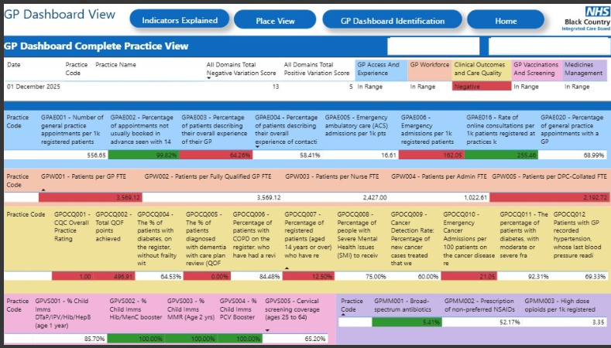

Slide 6
Indicators for Secretary of State briefing
GPPS – Patient survey flagged if <60% GOOD overall
Total appointments flagged if <300 appointments per 1000 patients
Appointments with a GP flagged if less than 25% delivered by a GP
Acute appointments flagged if <60 seen same day/next day
Patients per GP flagged if > 4000 patients per GP
Diabetes flagged if <50% patients with an appropriate reading
CVD flagged if less <55% patients with an appropriate reading
ACS (Ambulatory Care Sensitive) >30 admission per 1000 patients

Slide 7
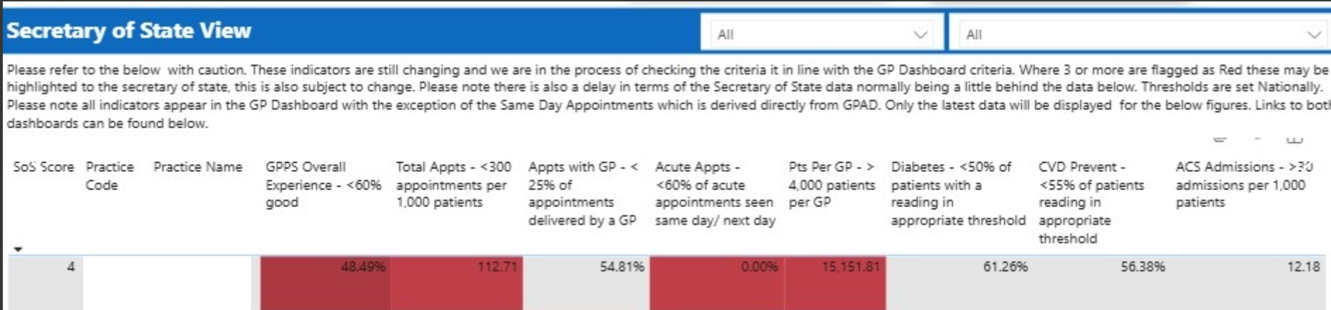

Slide 8
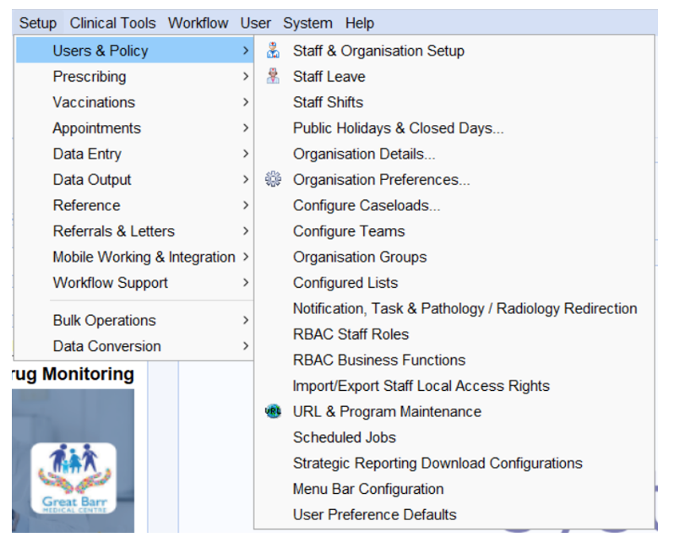
Accessing Slot Types – Systm1
Step 1
Navigate to ‘Setup’, then ‘Users & Policy’, then ‘Organisation Preferences’.

Slide 9
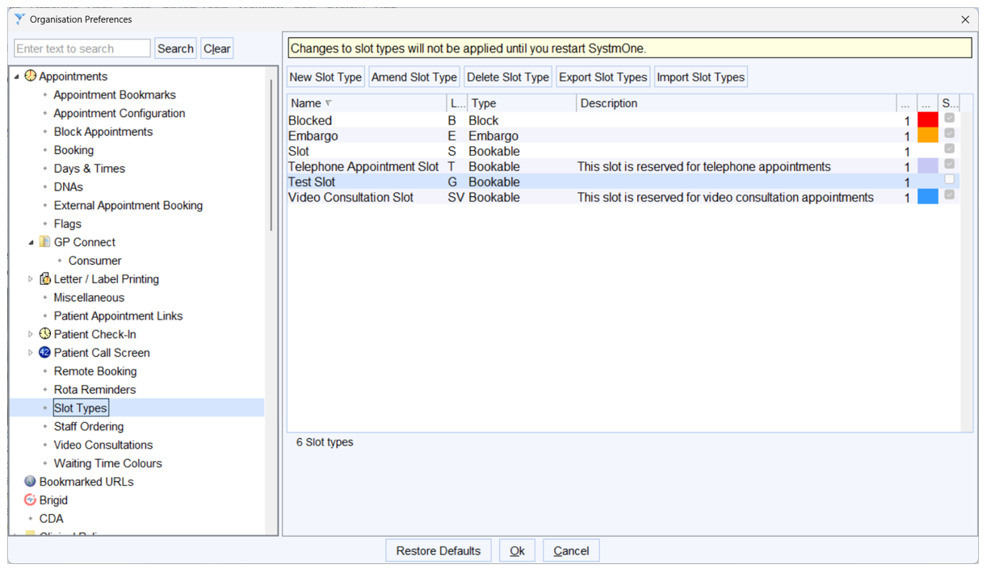
Step 2
On the left hand side under the ‘Appointments’ node you will see an option called ‘Slot Types’. Select this to review all your active appointment slot types.
Step 3
You can use the ‘Amend Slot Type’ button at the top of the right pane to change any details including the National Category the appointment slot is linked to.

Slide 10
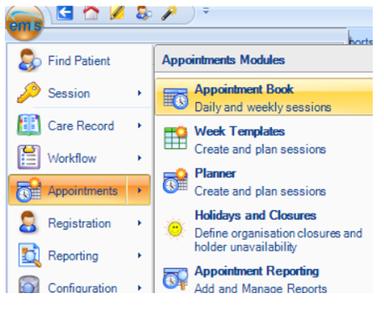
EMIS
Step 1
Navigate to ‘EMIS’, then ‘Appointments, then ‘Appointment Book.

Slide 11
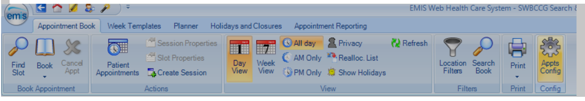
Step 2
From the appointment book select the far right button labelled “Appts Config”.

Slide 12
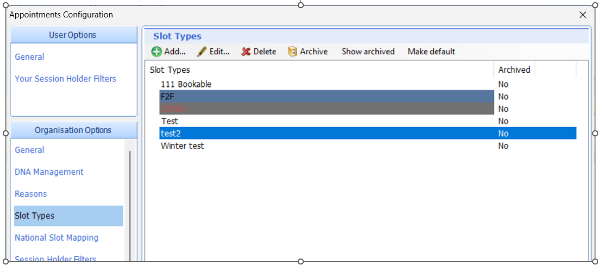
Step 3
Select “Slot Types” in the left hand pane and you can then use the “Edit” button.
Step 4
Any details including the National Category the appointment slot is linked to can be changed from here.

Slide 13
GPAD Mapping Reminder
There are four available ‘service settings’:
General Practice – this should be applied to all appointments delivered by practice staff activity under the GMS/PMS/APMS.
Primary Care Network – appointments delivered by staff employed or engaged under the Additional Roles Reimbursement Scheme (ARRS)undertaking service requirements of the Network Contract Directed Enhanced Service (DES) - e.g. Structured Medication Reviews, weekly care home rounds - with the exception of Extended Access services, for which the Extended Access
Extended Access Provision – this should be applied to all appointments commissioned as part of extended access
Other – this can be applied to record appointments delivered in the practice by another provider (if the system appointment book is used to record this activity) such as ICB led ARI Hub

Slide 14
GP appointment categories are subdivided in three ‘context types’:
Care related encounter: These categories involve the patient and can be any modality e.g. face-to-face appointments, telephone consultations, video and online consultations, home visits etc.
Care related activities: These categories do not involve the patient but are about the patient; clinical tasks and activities undertaken on behalf of the patient.
Administration and practice staff activities: These categories are for all activities and tasks required for managing a general practice and its staff.
Note
The categories in these context types have been included not because Practices are expected to record these activities in appointment books, but because some practices do record these activities in appointment books, therefore the categories have been made available to distinguish these activities from care-related encounters.

Slide 15
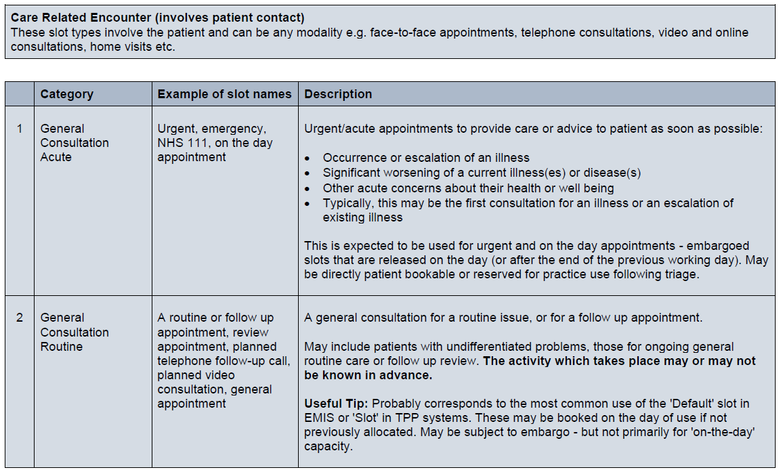
Care Related Encounter categories

Slide 16
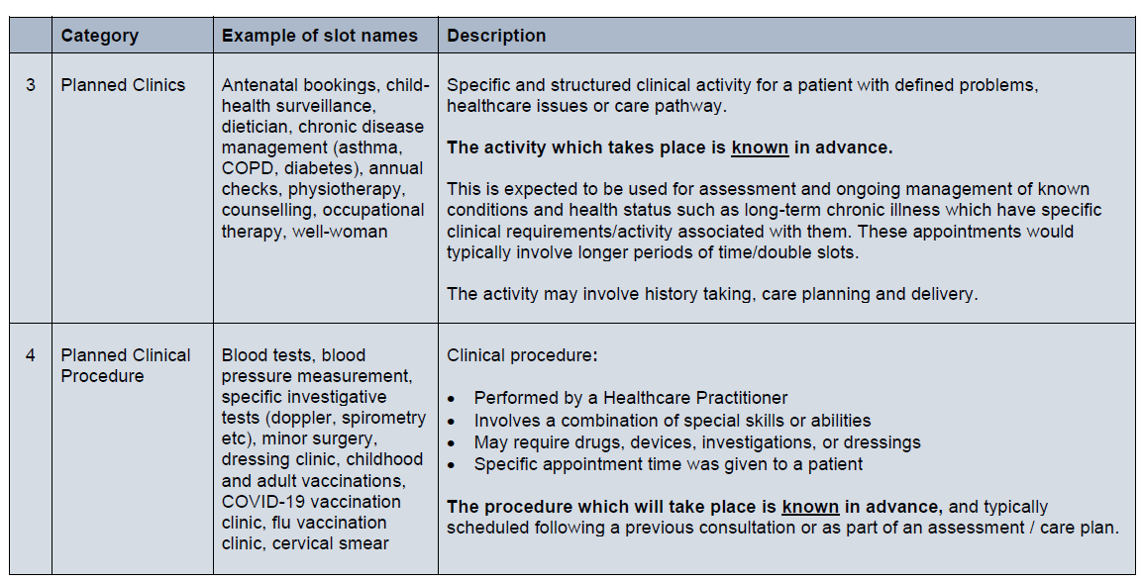

Slide 17
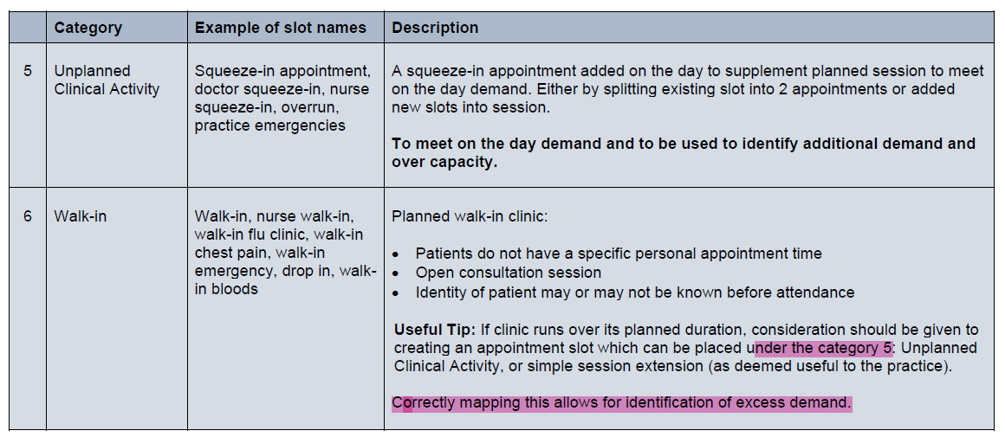

Slide 18
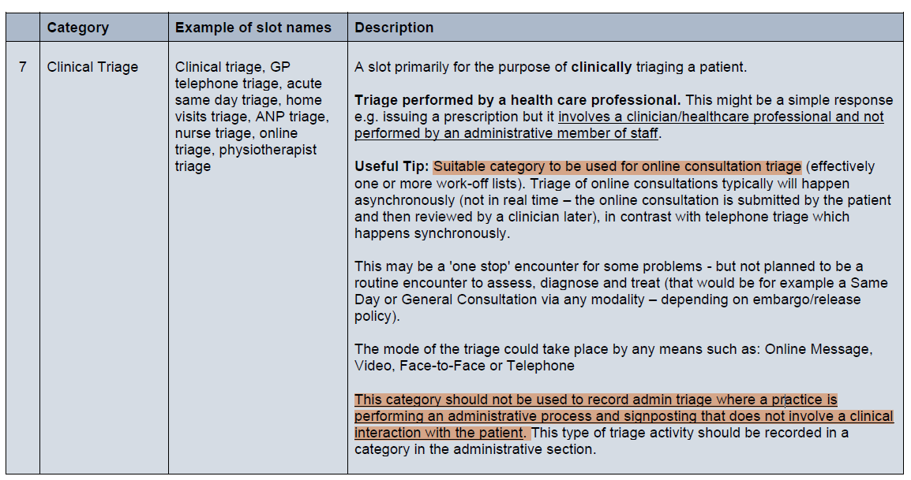

Slide 19
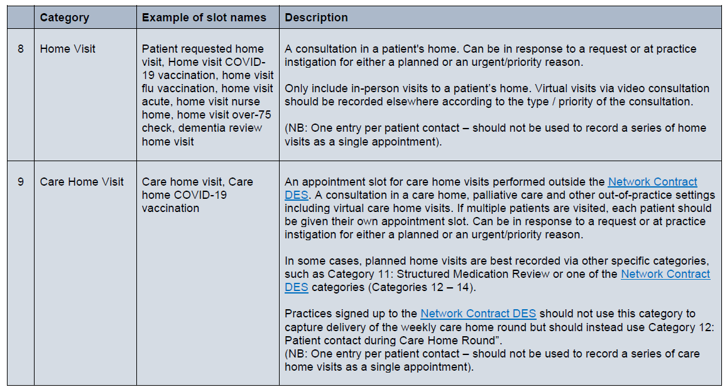

Slide 20
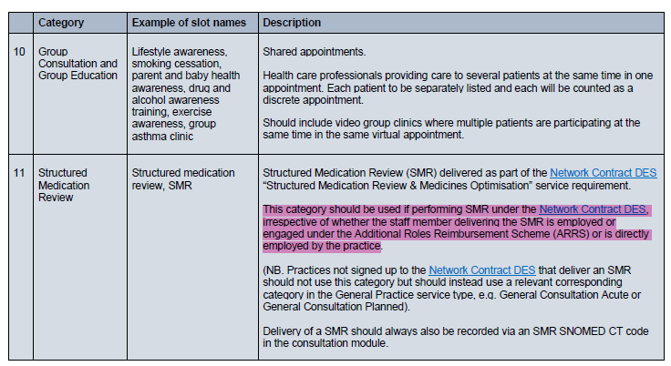

Slide 21
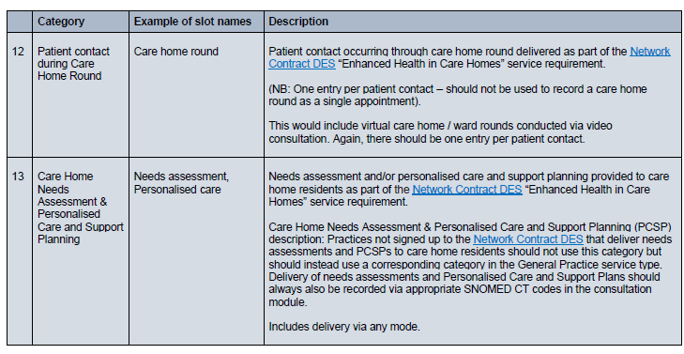

Slide 22
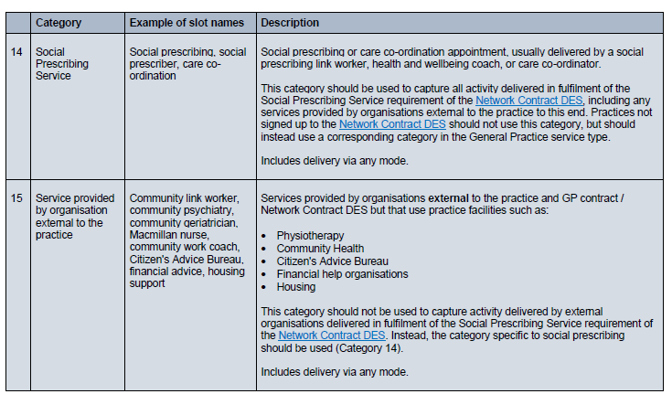

Slide 23
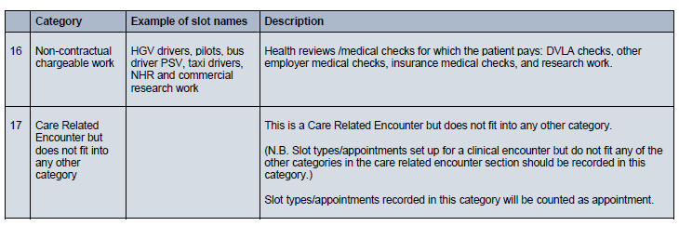

Slide 24
Link to National GPAD Guidance and Dashboard links
Data Quality Categorisation for COVID-19 Vaccine Clinic (Ignore title it is GPAD Link)
GP Appointments Data Dashboard - NHS England Digital
PCN appointments data dashboard user guide - NHS England Digital

Slide 25
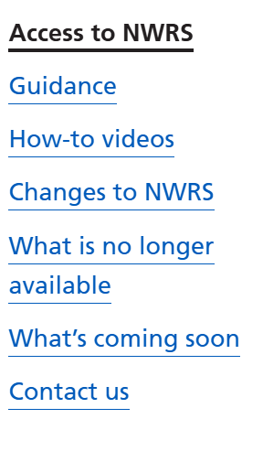
NWRS – Useful Links
The National Workforce Reporting Service (NWRS) support - NHS England Digital
How to guides/videos:
How to add a member of staff in a Primary Care Network (PCN)
How to add a locum who works occasionally at your practice
How to understand error messages
How to delete a staff record
Patients per GP flagged if > 4000 patients per GP

Slide 26
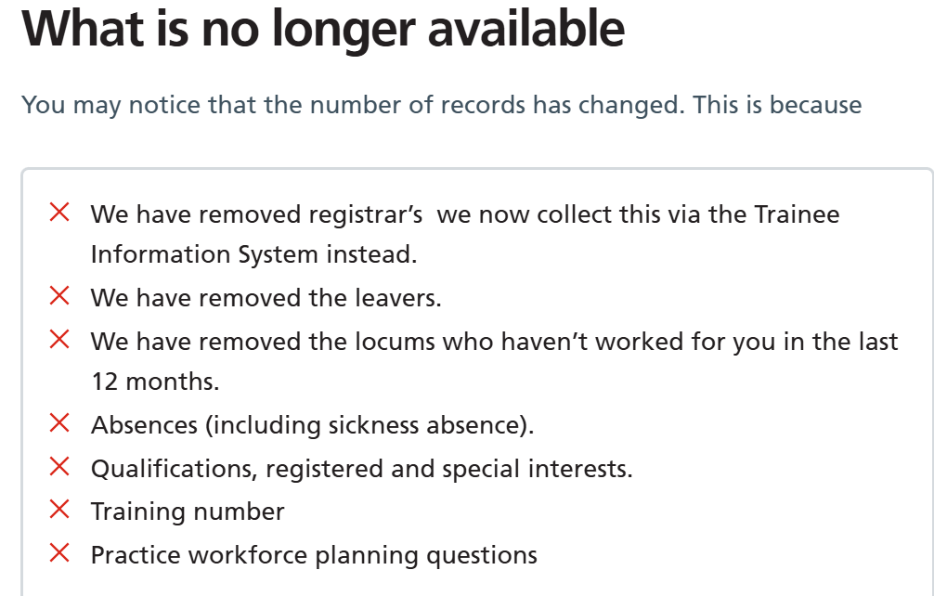

Slide 27
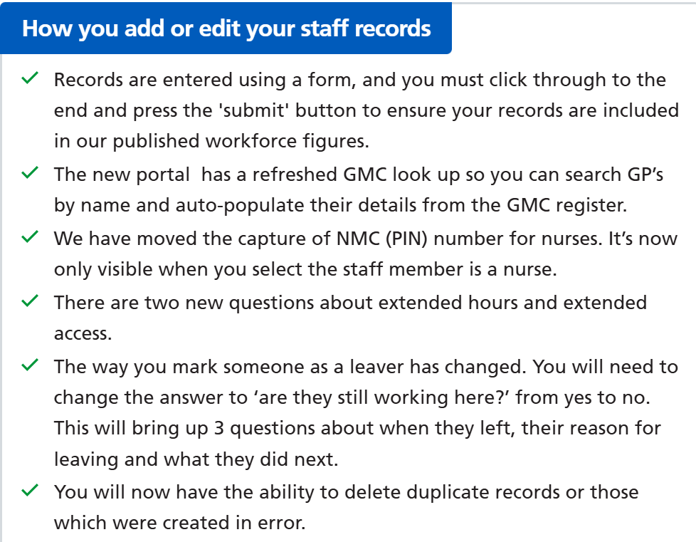
Changes to NWRS

Slide 28
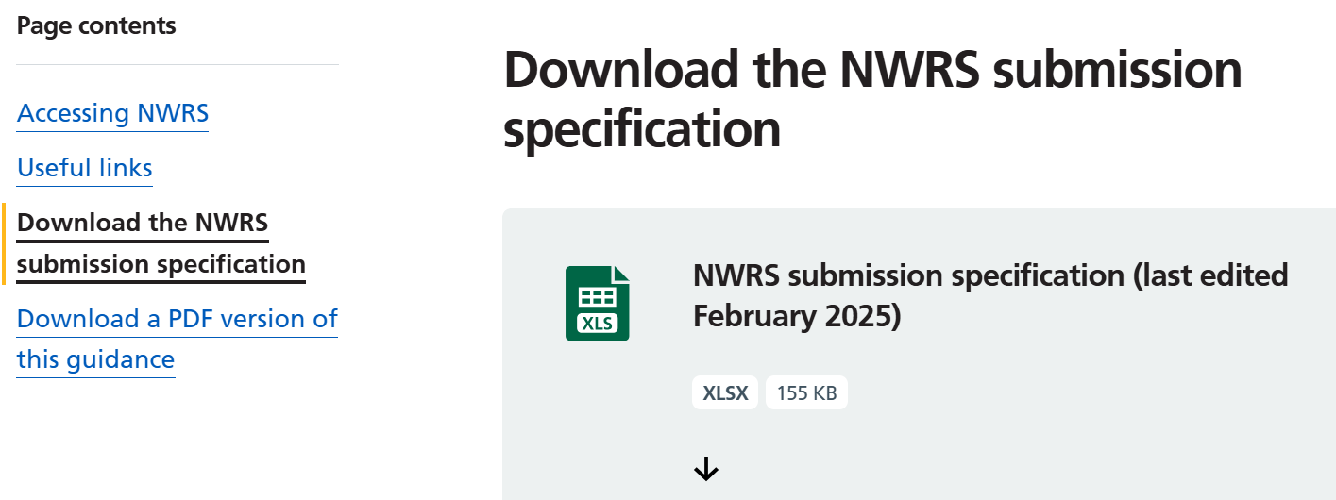
National Workforce Reporting Service (NWRS) guidance and support - NHS England Digital

Slide 29
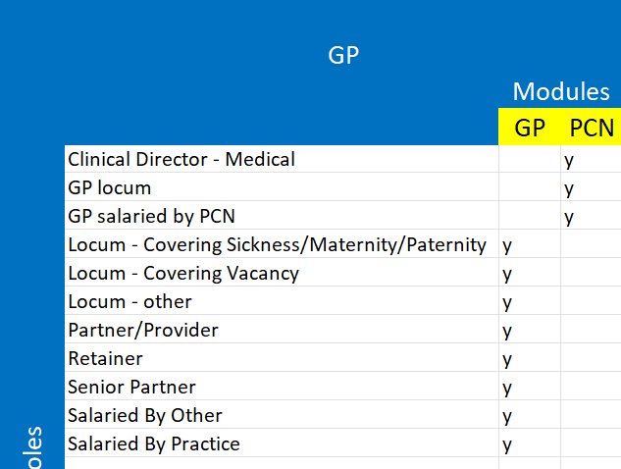
Staff Members

Slide 30
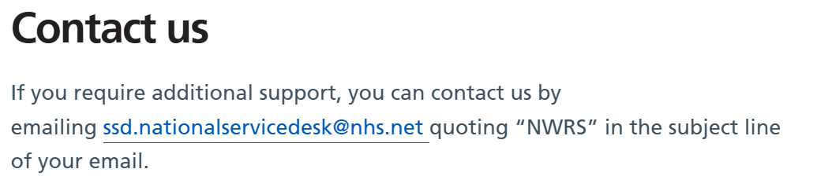
NWRS

