Slide 1
Personal Health Records (PHR) Primary Care Collaborative: PKB Switch On
Neill Crump – Digital Strategy Director

Slide 2
What is a Personalised Health Record (PHR)?
A Personalised Health Record / Patient Held Record (PHR) is a secure, digital record owned by the patient, connected to the NHS App, that allows individuals to view, manage, and share their health information from across care settings - hospital, community, and GP.
In simple terms: A PHR brings together the information a patient needs - from different NHS systems - into one place and enables two-way communication between patients and their care teams.

Slide 3
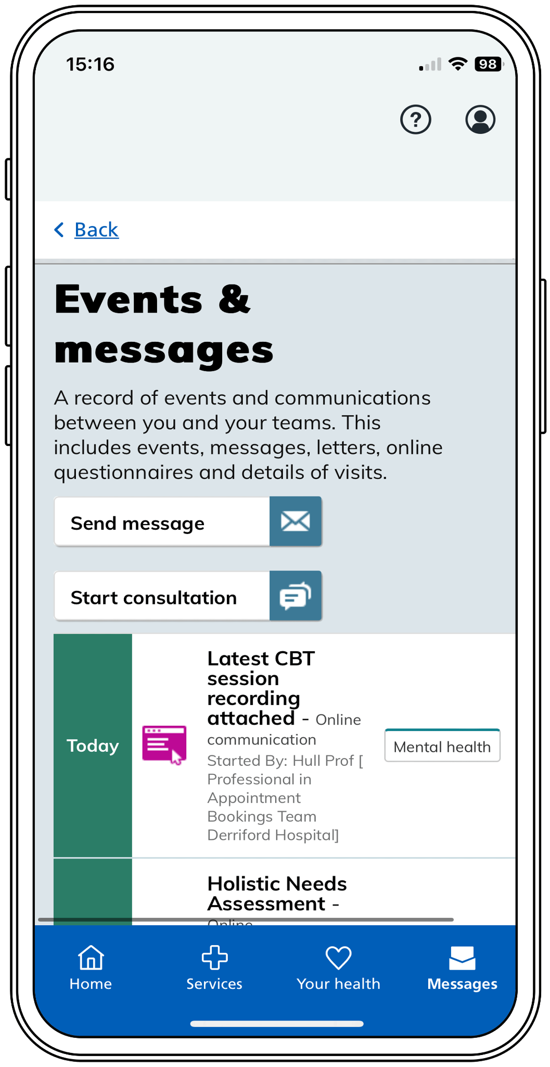
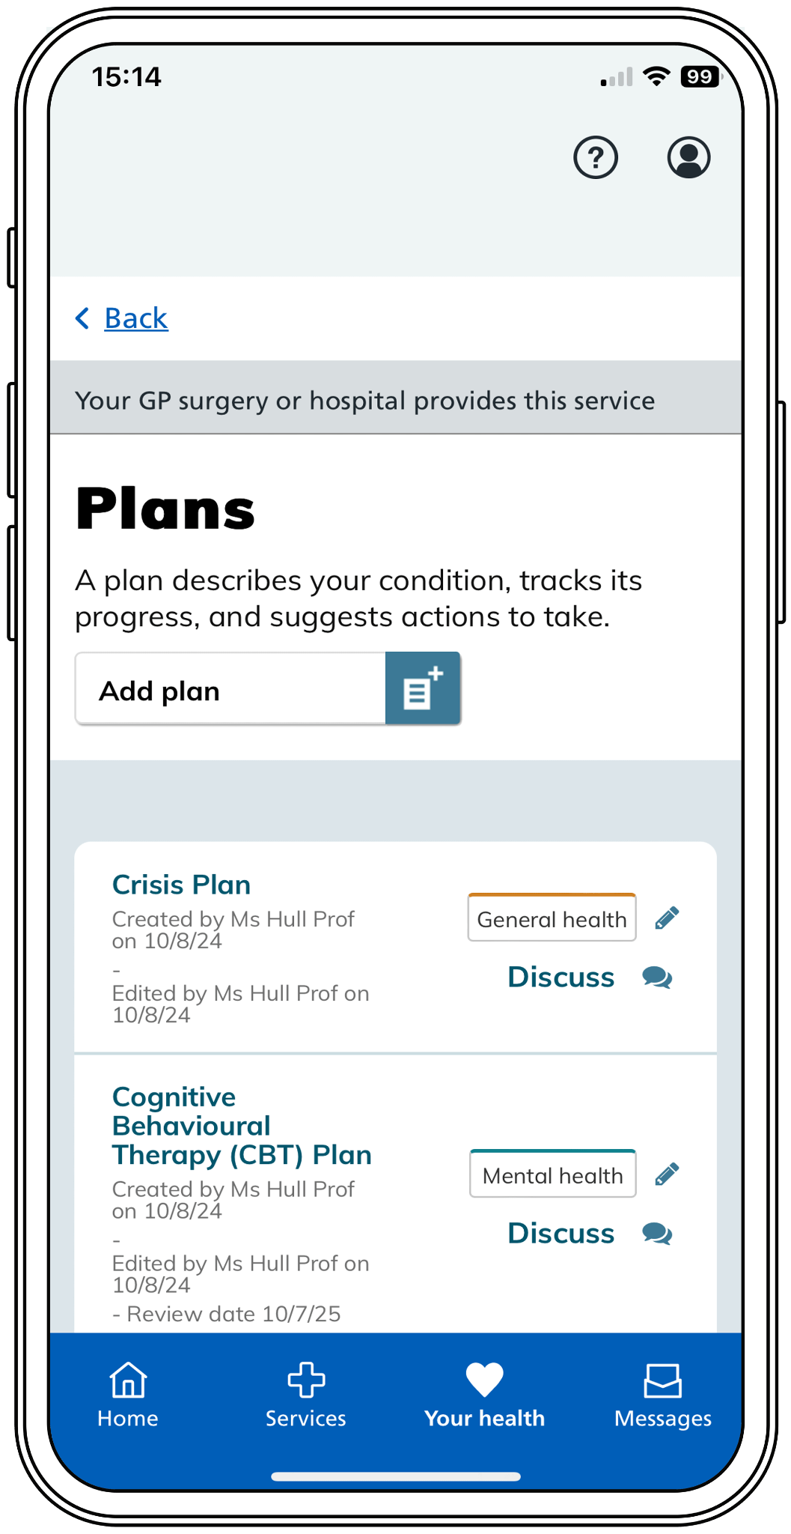
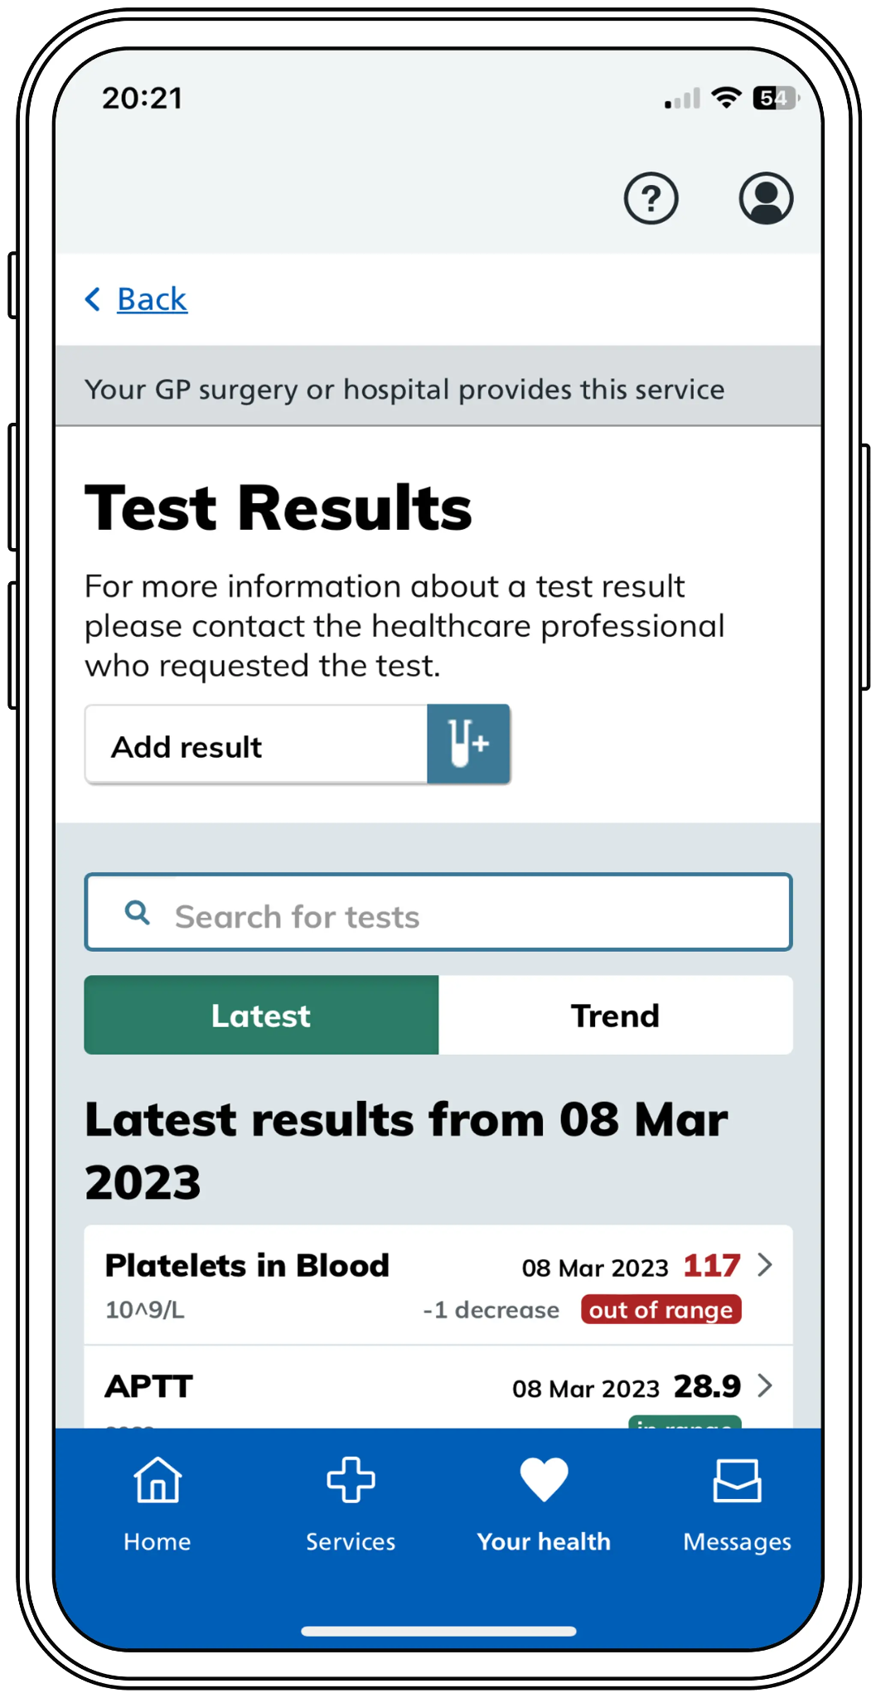
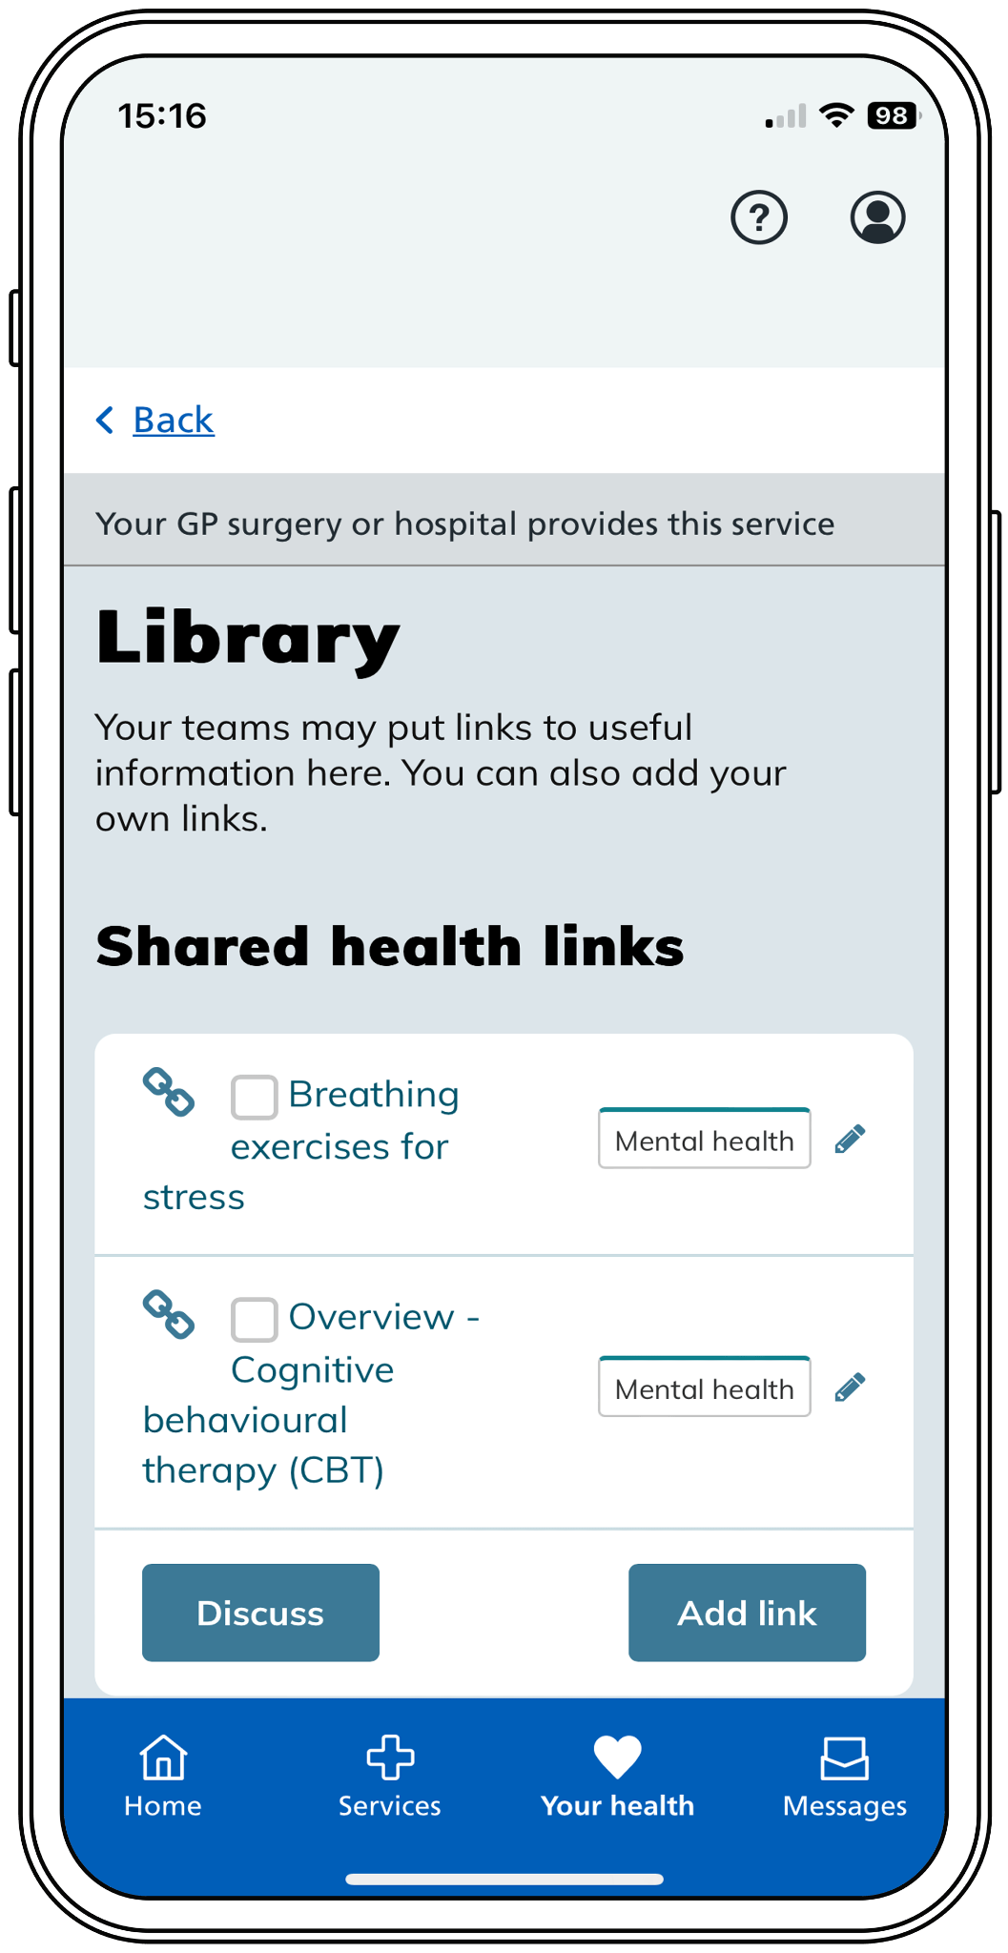
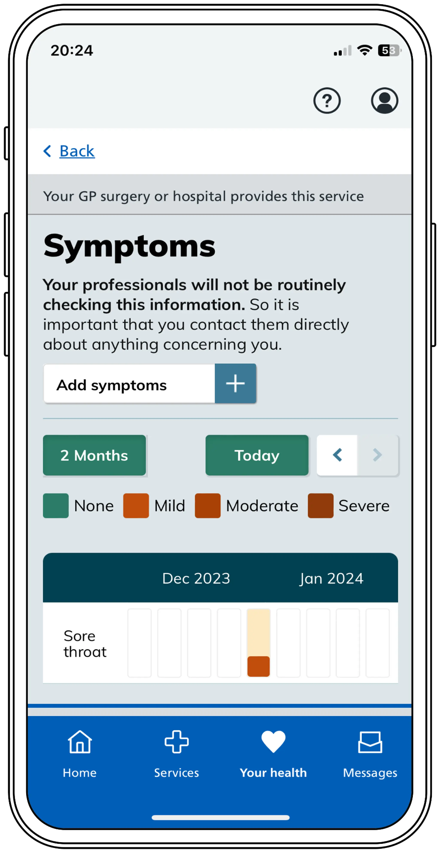



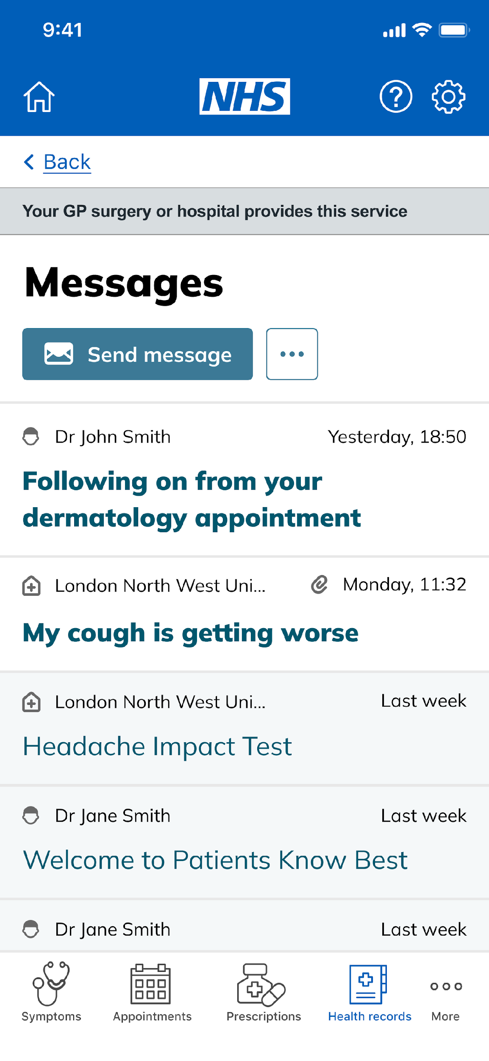
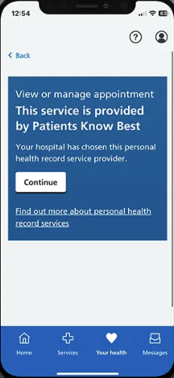
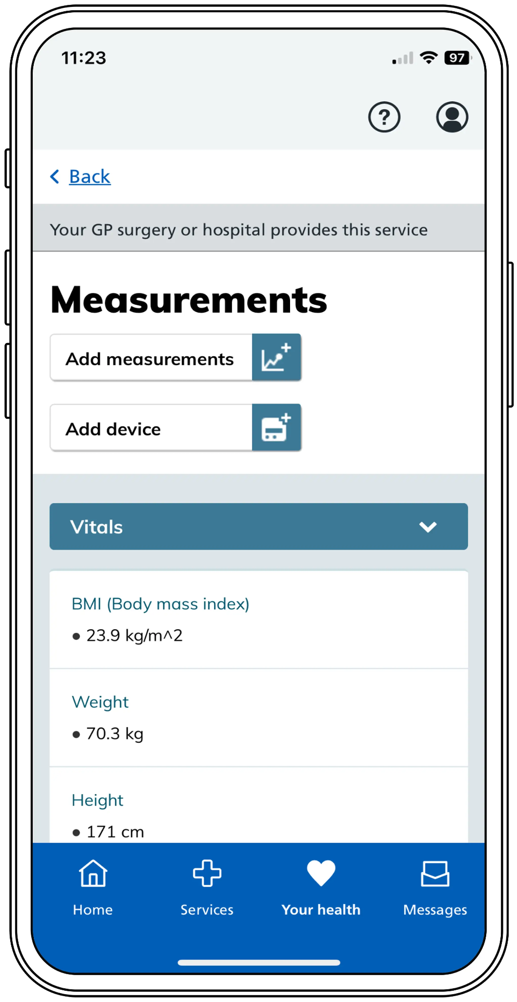
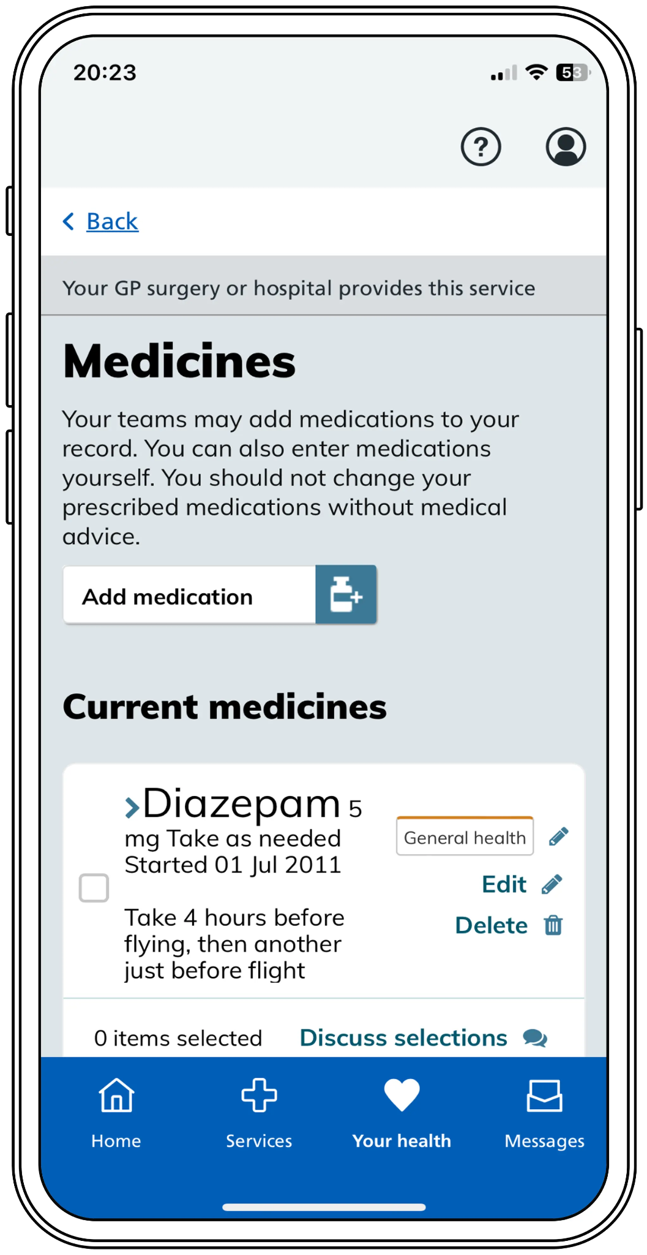
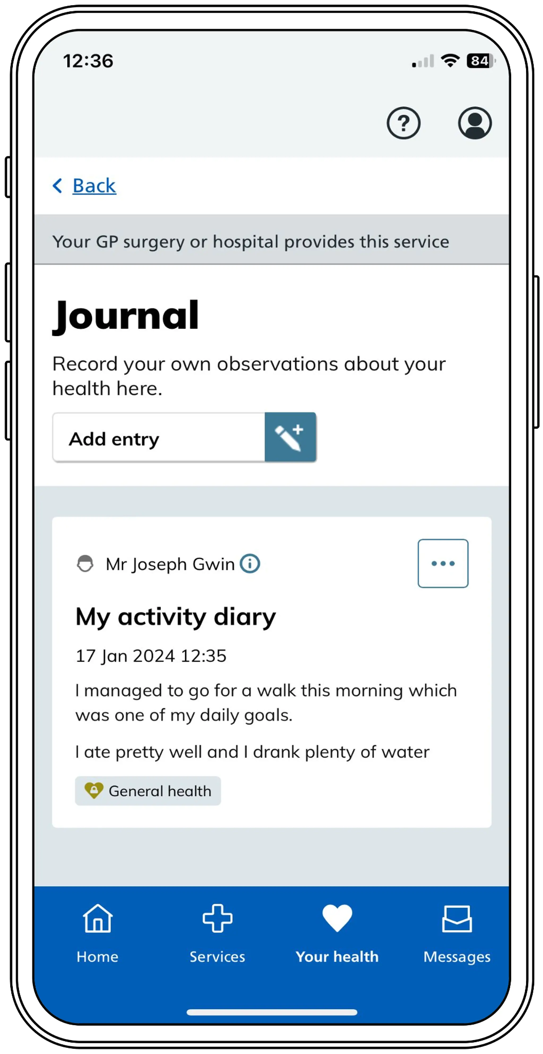
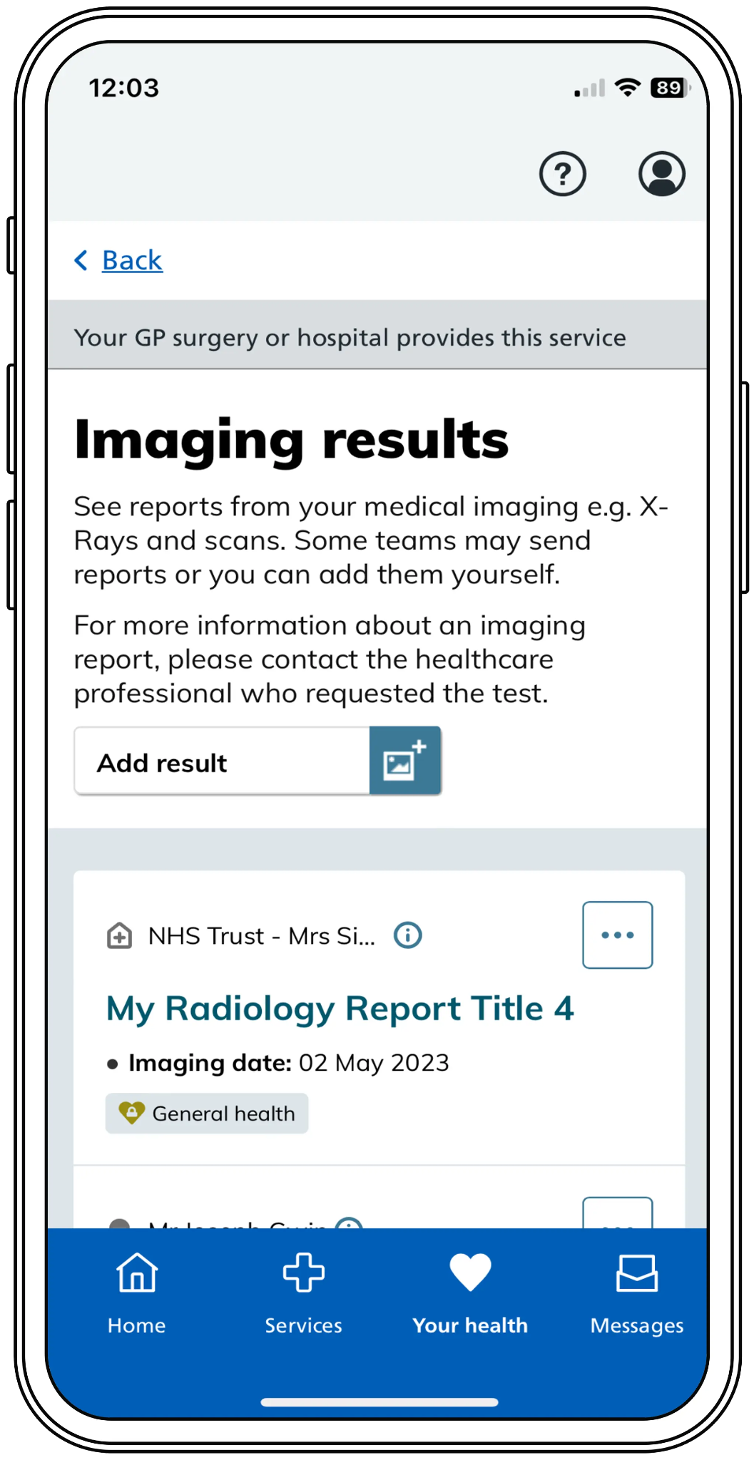
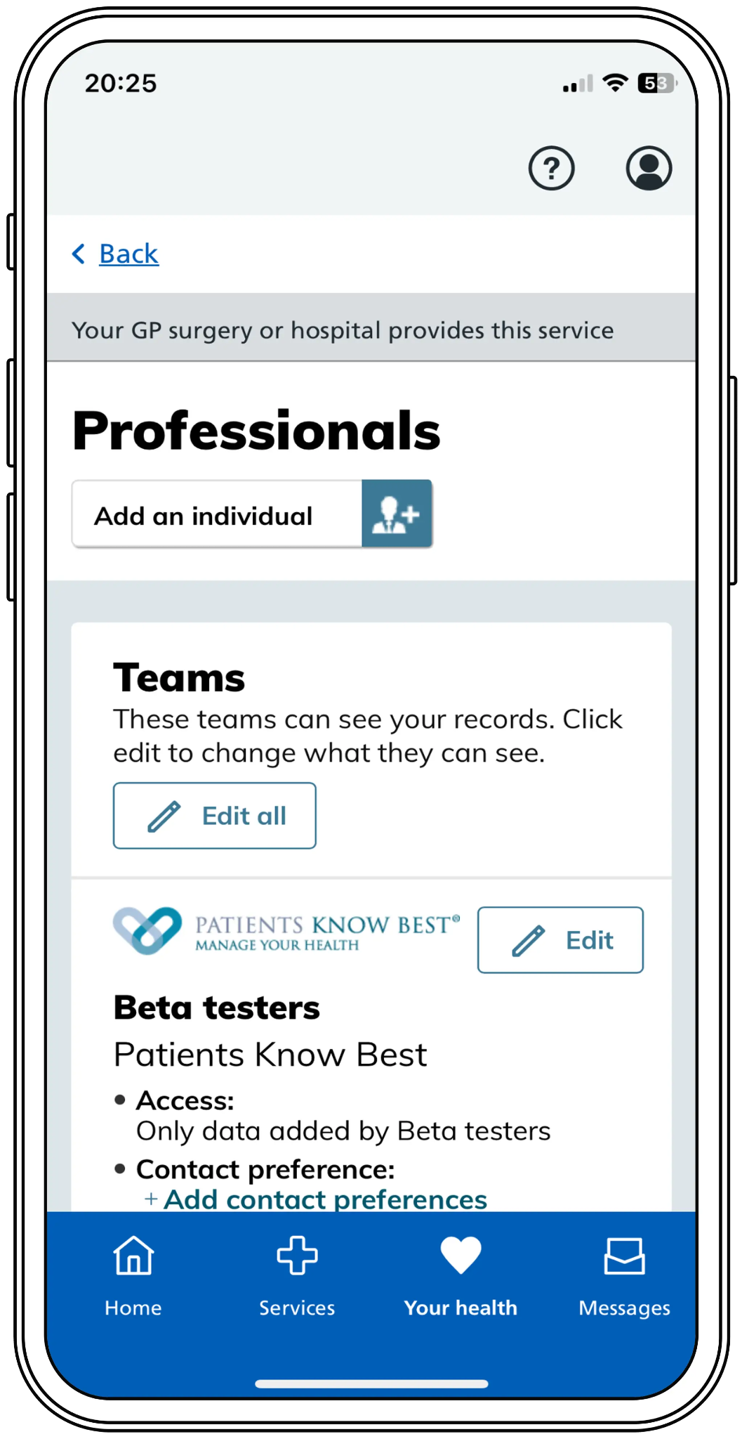
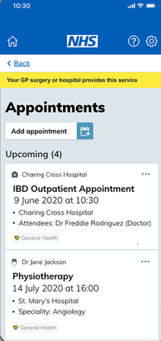
PKB integrated with NHS App and NHS login
Personalised Health Records: PKB Summary
NHS login is utilised to support registration and single sign-on process into PHR
PKB provides 10 additional screens that no other supplier provides in the NHS App
Wayfinder PEP functionality: appointment management, notifications and messages.
“Events and Messages” include asynchronous messaging, questionnaires, ADT's and digital correspondence such as appointment letters, clinical outcome letters and discharge summaries.

Slide 4
FAQ
Question | Headline
Is it a Portal? | The PHR is not just a portal — it’s a single, trusted front door via the NHS App where patients can view, manage, and contribute to their care
What does “switching on PKB within the ICS” mean for our local practices and patients? | Via PKB, every adult registered with a GP in England can — with their consent — bring a copy of their GP record into their personal health record and view it via the NHS App.
Do Practices need to do anything? | No. Patients can self-activate via NHS Login, and GP data flows automatically without additional GP workload. “switch-on” means PKB becomes available across the ICS footprint. Practices do not need to enable, configure, or manage PKB locally.
How does the integration work? | The integration uses the national “GP Data for Any Adult in England” service and does not require practice-level onboarding.
Does this create extra work for GP practices? | No. PKB uses read-only national GP data feeds, and the patient activates their own account via NHS App → PKB. There is: No practice configuration No new workflows to maintain No additional data entry No tickets or onboarding meetings with suppliers
Notes:
nationwide GP-data integration, covering demographics, diagnoses, medications and appointments
The PKB software enriches the data released from the GP to the patient by adding SNOMED CT codes, including those for conditions and medications.
This creates a combined set of coded data – including observations, measurements and symptoms entered by the patient or professionals – which can enable automated information support for patients in the future.

Slide 5
FAQ
Question | Headline
Will there be an impact on Practices? | Most practices notice a reduction in routine administrative queries (results, summaries, medication lists)
How will the patient initially access their PHR | Patients add their GP data to their PKB record by logging in with their NHS login and selecting ‘Get my GP data’.
What GP data will patients see in PKB? | When a patient links PKB through NHS Login, they can see a copy of their GP record, including: Demographics Medications Allergies Problems Appointments This mirrors what they can see in NHS App however assembled within a unified personal health record.
Does PKB change or access the GP clinical system? | No. PKB does not write to, alter, or connect directly into EMIS, TPP, or Vision systems. It only receives read-only national GP data extracts already approved for patient access. There is no impact on GP system performance.
Notes:
nationwide GP-data integration, covering demographics, diagnoses, medications and appointments
The PKB software enriches the data released from the GP to the patient by adding SNOMED CT codes, including those for conditions and medications.
This creates a combined set of coded data – including observations, measurements and symptoms entered by the patient or professionals – which can enable automated information support for patients in the future.

Slide 6
FAQ
Question | Headline
What other functionality will PKB provide to the patient / citizen / carer? | The NHS App integration displays the PKB user interface inside the NHS App. This gives the NHS App user full PKB functionality, much deeper than the standard NHS App functionality limited to just the GP. This can include: hospital data including medications, appointments, test results, radiology reports, appointment letters, clinic letters, discharge letters online consultations with free text and structured questionnaires secure messaging including attachments (pictures/videos) symptom tracking educational digital library of resources measurements including device integration including over 100 wearables for tracking activity, blood pressure, weight and glucose shared care planning record sharing / consent management
Notes:
nationwide GP-data integration, covering demographics, diagnoses, medications and appointments
The PKB software enriches the data released from the GP to the patient by adding SNOMED CT codes, including those for conditions and medications.
This creates a combined set of coded data – including observations, measurements and symptoms entered by the patient or professionals – which can enable automated information support for patients in the future.

Slide 7
FAQ
Question | Headline
Do practices need to approve or verify patients? | No. Identity verification is handled by NHS Login, not by the practice. Patients self-activate their PHR in PKB without staff involvement. PKB have a service desk if patients have any queries. PKB handles all different scenarios with the patient without requiring any support from local health care providers. PKB's software walks the patient through their options. If a patient is stuck, they contact the PKB support desk on help@patientsknowbest.com and PKB employees handle the questions. None of the ICSs using PKB in the NHS App have reported queries to staff from patients
Will this replace other local digital tools? | No immediate replacement. PKB provides a platform for multi-provider shared records, messaging, care plans, and remote monitoring. It complements existing systems and can integrate with future ICS digital pathways.
Can practices opt out? | No, because PKB’s data access is based on national patient rights to view GP data and does not require practice-level deployment. However, practices can choose whether they want to adopt additional PKB features (e.g., messaging, questionnaires) in the future.
Notes:
nationwide GP-data integration, covering demographics, diagnoses, medications and appointments
The PKB software enriches the data released from the GP to the patient by adding SNOMED CT codes, including those for conditions and medications.
This creates a combined set of coded data – including observations, measurements and symptoms entered by the patient or professionals – which can enable automated information support for patients in the future.

Slide 8
FAQ
Question | Headline
What should practices do next? | Nothing technically. Practices may choose to: Brief staff so they can signpost patients confidently Share ICS communications material Encourage patients already using NHS App to activate PKB The DGFT / ICS digital team manages rollout, technical configuration, and pathway work.
Are there any legal / technical requirements? | PKB’s IM1 (Interface Mechanism 1) integration and NHS App connection are centrally approved APIs and certified by NHS England. Access is patient-mediated – the patient authorises PKB via NHS Login to receive a copy of their GP data. IM1 ensures integrations are secure, audited, and compliant with NHS Digital standards. The integration works side by side with any other integrations GPs are using in the area so there is no downside or effort in switching on this functionality Legally, the ICS or Trust does not need GP permission to proceed
Is this approach tried and tested? | Yes, 22 of the 42 ICSs have already completed for their region
Notes:
nationwide GP-data integration, covering demographics, diagnoses, medications and appointments
The PKB software enriches the data released from the GP to the patient by adding SNOMED CT codes, including those for conditions and medications.
This creates a combined set of coded data – including observations, measurements and symptoms entered by the patient or professionals – which can enable automated information support for patients in the future.

Slide 9
FAQ
Question | Headline
Will it add additional cost to primary care? | No, nationally funded for the first 3 years and sustainable business case for year 4 onwards
Is the PHR linked to to one Trust and their systems (e.g., DGFT and Altera EPR) | No it can provide converged record spanning multiple providers and their systems so patient has one unified record across the NHS and other organisations - managed by the patient, with NHS App login
When will we deliver? | PKB Switch on between Feb and March 2026. NHS App integration will be delivered by March 2026 so we can implement to services thereafter.
Will it give us opportunity to support our PCNs? | Yes, it will transform how patients can receive personalised care and enhance care coordination. Patients can share their complete health record with family members, carers, and any healthcare professional globally.
Is this approach scalable? | Yes, there are examples of ICSs who have deployed across primary, secondary, social care, mental health, community and voluntary care organisations
What happens at ‘switch on’ | no GP Data will flow through to PKB. Patients who use PKB can choose to store a copy of the GP record the GP has already released to the patient into the NHS App. It does not cause any data release, the GP remains in control of all GP data release In the NHS App, a pop-up in PKB will directly ask the patient if they consent to allowing PKB to store a copy of their GP Data.
Notes:
nationwide GP-data integration, covering demographics, diagnoses, medications and appointments
The PKB software enriches the data released from the GP to the patient by adding SNOMED CT codes, including those for conditions and medications.
This creates a combined set of coded data – including observations, measurements and symptoms entered by the patient or professionals – which can enable automated information support for patients in the future.

Slide 10
FAQ
Question | Headline
What are the IG implications? | NHSE have already completed certification of PKB as part of IM1 Integration processes, where patients directly authorise storing in PKB a copy of the data NHSE has the following agreements in place with PKB; NHS Connection Agreement, Model Interface License's covering GP EHR Systems and IM1 PFS SCAL Patient gives Explicit Consent to PKB to store GP data (which is data already visible in the NHS App to the patient) No data flows from Acute Trusts until they separately sign contract with PKB at which point data controllers from each Provider would establish relevant governance ICB IG have reviewed and confirm that all due diligence has been followed
What are the benefits for primary care? | Fewer admin calls requesting results or summaries Patients arrive better informed → fewer consultation minutes spent clarifying history Supports prevention, LTC management, and personalised care Reduces digital inequality by giving all patients a unified PHR across care settings
Notes:
nationwide GP-data integration, covering demographics, diagnoses, medications and appointments
The PKB software enriches the data released from the GP to the patient by adding SNOMED CT codes, including those for conditions and medications.
This creates a combined set of coded data – including observations, measurements and symptoms entered by the patient or professionals – which can enable automated information support for patients in the future.

Slide 11
Switch on Approach
Action | Purpose / Outcome | Timing
Primary Care Collaborative | Ensure practices understand that PKB’s IM1 integration is patient-initiated, read-only, and centrally approved by NHS England. Reinforce that no local configuration or data-sharing changes are required. | Dec 2025 to Jan 2026
GP-facing communications pack | Issue clear, consistent messaging (based on Greater Manchester ICS model) describing what patients will see, where queries are routed, and that practices need take no action. | Jan to Feb 2026
FAQs and PKB NHS App Toolkit circulation | Supply practical resources to support practice teams in conversations with patients (if they arise) and reduce misinformation. | Jan to Feb 2026
Digital inclusion and IG reassurances | Highlight compliance with NHS England governance and accessibility standards. | Jan to Feb 2026
Switch on / Readiness | PKB and Trust technical go-live sign-off, NHS App configuration, patient comms prepared, switch on | Feb to March 2026
Primary Care Collaborative | Maintain a standing agenda item at meetings for PKB progress, feedback, and lessons learned. | Ongoing pre- and post-go-live
Notes:
nationwide GP-data integration, covering demographics, diagnoses, medications and appointments
The PKB software enriches the data released from the GP to the patient by adding SNOMED CT codes, including those for conditions and medications.
This creates a combined set of coded data – including observations, measurements and symptoms entered by the patient or professionals – which can enable automated information support for patients in the future.

Slide 12
Appendices

Slide 13
Example GP Communications (Manchester Example)
“We’re writing to you to inform you that our ICS is in the process of approving the switch-on of the Patients Know Best (PKB) and NHS App integration in the area. PKB is a Personal Health Record that allows patients in Bolton and the Greater Manchester ICS to access and manage their secondary care health information (such as appointments, letters, lab results and much more), as well as add their own data such as measurements or symptoms, to support their direct care and self-management. The integration allows patients to access their PKB records via the NHS App front door, in line with national guidelines, and will complement the current primary care data available in the App.
You can find out more about PKB’s integration with the NHS App and login here. It is useful for you to be aware of what’s happening in the region in case patients ask you about it, but there is nothing the GP practices need to do. Any queries from patients will be directly signposted to the Hospitals support team or PKB’s support team.”

Slide 14
PHR Core Capabilities
PHR Core Capabilities | Patient Benefits | Primary Care Benefits
Wider Access to Health Records (medications, allergies, consultations, results) | Better understanding of health; reduced anxiety; supports self-management of long-term conditions | Fewer record/results enquiries; improved consultation quality; better medicines optimisation
Personalised Care Plans (e.g. LTCs, maternity, frailty, diabetes) | Clear goals and actions; increased confidence in managing conditions; support for carers | Better LTC oversight; earlier intervention; supports QOF/personalised care requirements
Test Results & Notifications | Quicker access to results; decreased uncertainty and wait times | Fewer calls for results; consistent messaging; more efficient follow-up processes
Carer / Proxy Access | Carers can manage care safely on behalf of vulnerable people | Reduced admin burden; improved continuity and safeguarding for frail/complex patients
Health Promotion & Preventive Messaging | Reminders for screening and vaccinations; better engagement in prevention | Improved uptake of prevention programmes; reduces manual outreach
Patient Education & Condition-Specific Content | Improved understanding of conditions and treatments; better self-care | Reduced repetitive explanations; supports shared decision-making and behaviour change

Slide 15







PHR Functionality and Benefits
Interactive features
Supporting digital pathways; eMeet&Greet referral package, waiting well, wait list validation, pre and post op assessments, prehab, enhanced supported discharge process and patient initiated follow up.
Asynchronous Messaging
Symptom Tracking
Assessment
Questionnaires
Library of Resources
Shared Care Planning
Journal
Entries
Measurements and Device
Integration
Data Feeds
Reducing costs associated with digital interactions (reducing paper based letters and reducing DNA rates).
Saving clinical and admin time by reducing patient phone calls associated with appointment and result data.
Demographics
Test
Results
Digital
Documents
Inc Hybrid Mail
Appointment
Management
Diagnosis Medications Allergies
Imaging
and Radiology

