Slide 1
LMC meeting – comms update
14 June 2023

Slide 2
Primary Care Recovery Plan
Launched in May. Covers many areas but from a comms POV there are three things that national team will concentrate on patients knowing about:
Digital access –using the online consultation facility. Likely to land in Q3 it will be a campaign possibly using the Help Us Help You brand​
Wider practice team – socialise the notion that pts will be asked by reception / care navigators why they’re calling so they can be referred to the most appropriate person, which may not be a GP. This will start later this month with a series of paid-for articles in national newspapers​
Wider care available (alternatives to GP) – encourage the public to use other services. Likely to be NHS111 online focused and building on NHSApp capabilities​
All of these already have campaign materials supporting them
England, www.england.nhs.uk, Sept

Slide 3
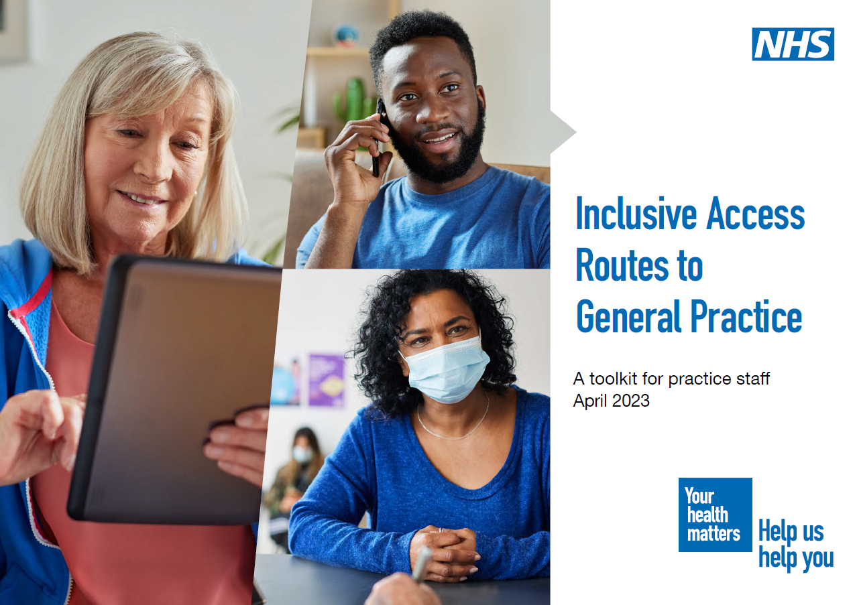
"Inclusive Access Routes" toolkit to support practice staff
Covid response showed not all pts need / want f2f appts
Pts who like using online aren’t confident using online forms for GPs. Often don’t know they exist or where to find them
Package of updated materials sent to all practices (addressed to practice manager at surgery's main address) – delivery from 25–27 April
They help practice teams explain to patients the three ways they can access care, helping build confidence in these routes
They include: posters, counter cards, leaflets for reception areas, plus an overview of the toolkit for all practice staff
The materials were first published in January 2022. The updated version is now available. ICB comms leads can access the materials.
, Sept

Slide 4
MDT teams
We know there is a shortage of GPs
The public often want to see a GP when there are other more appropriate health care professionals
We need to educate patients that the GP practice can make sure they see the right person for their healthcare needs by explaining more to the reception team / care navigator
There are materials already in place to help explain this:
Social media assets / comms toolkit
Posters
Digital screens
Roles covered include:
Care Coordinator, Clinical Pharmacist, Dietician, Healthcare Assistant, Health and Wellbeing Coach, Mental Health Therapist and Practitioner, Nurse, Occupational Therapist, Paramedic, Pharmacy Technician, Physician Associate, Physiotherapist, Reception Team, Social Prescribing Link Worker
ICB comms leads can access the materials to share with GP practices
, Sept

Slide 5
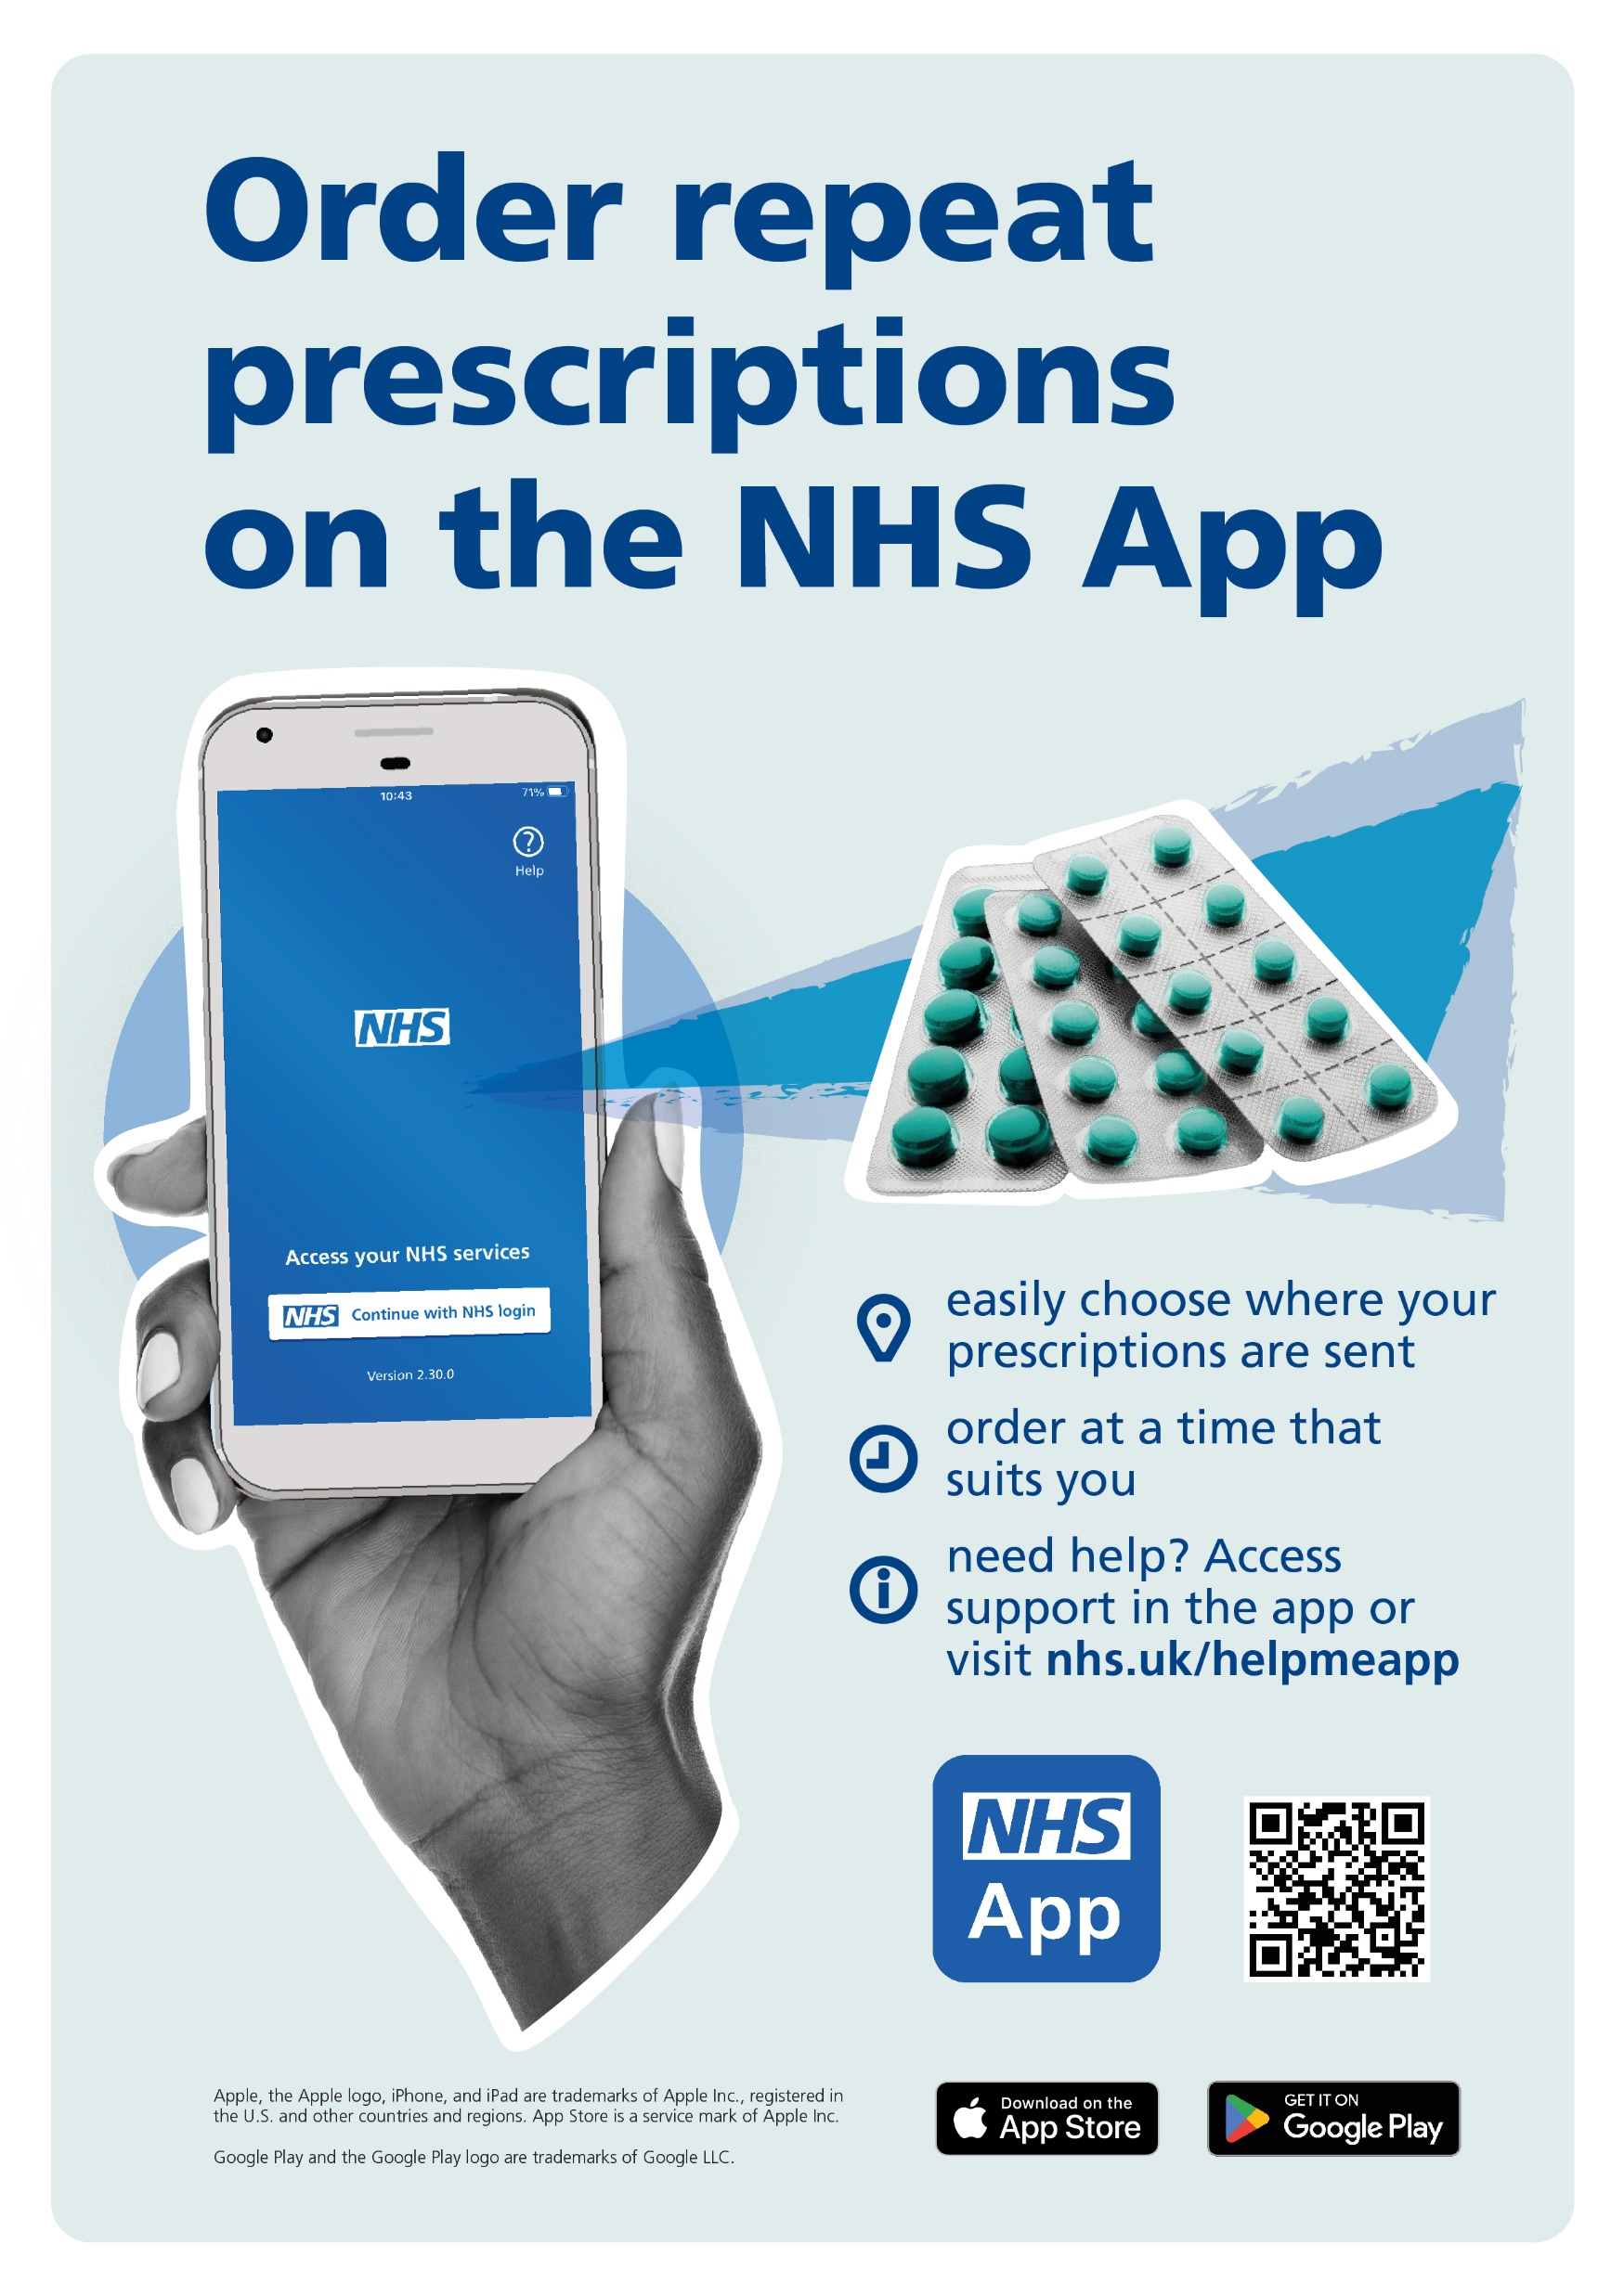
Wider care available
The NHSApp was designed as the ‘front door’ to healthcare using a digital platform
As of Jan 2023 30m people had downloaded the NHSApp
People that have the app and are comfortable using it are being encouraged to use it for requesting repeat prescriptions
A comms toolkit includes:
Posters
Leaflets
Digital and social media assets
More functionality is likely to come online
NHS111 online – www.111.nhs.uk
Users are asked the same questions as a call handler and end up with a disposition
Linked to the DOS
Designed for those confident and comfortable using technology
Can be access via the NHSApp / through tablet, desktop and laptop
A comms toolkit includes:
Social media assets
Leaflets
Digital screens

Slide 6
Other initiatives
Patient Choice
An area govt is exploring. More likely to emerge later in the year
Currently pts can see waiting times for hospitals on MyPlannedCare website
Interactive map lists wait times as well as advice on how to manage the condition / what to do should condition get worse
Comms materials are available for practices to use
Pharmacy
Designed to remind public that pharmacists can help with a range of conditions – earache, sore throat, itchy eyes
Campaign materials are available including:
Posters
Social media assets
Website content
Digital screens
Comms leads in ICBs have access to this and would be happy to share

