Slide 1
Weekly Covid-19 data update
30/04/2021
Contact: Frances Player, Policy Advice and Support Officer, Public Health and Healthcare
fplayer@bma.org.uk

Slide 2
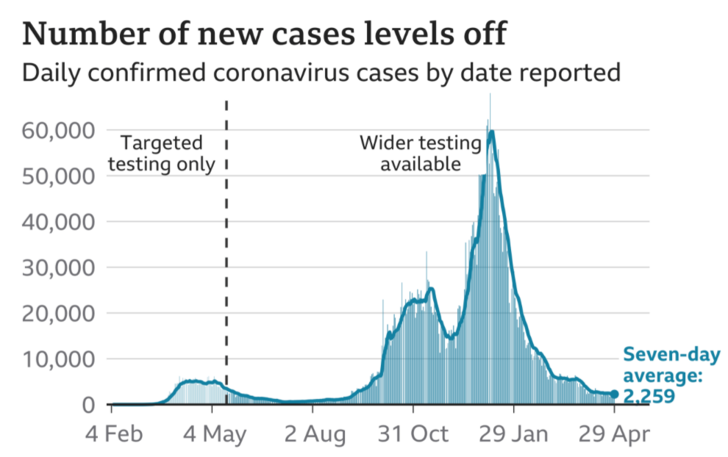
Cases – UK wide
Highlight:
Latest figures indicate there were 2,445 confirmed cases across the UK reported on 29 April. This compares to 2,729 new cases reported in the last update (22 April).
The graph indicates that the number of new cases are levelling out, with a seven-day average of 2,259. Cases still appear to be higher than in the summer, but substantially lower than the start of the year.
Source: Gov.uk COVID-19 dashboard (graph via BBC)

Slide 3
Cases by nation (and English regions)
Highlight:
Latest figures indicate a continued slight drop in the number of cases across England, Scotland, Wales and Northern Ireland. Cases appear to be slightly rising across several English regions, and there continues to be considerable variation in cases per 100k between different areas.
Cases per 100,000 by nation, last 7 days
Cases per 100,000 by English region, last 7 days
English Region | Cases per 100k | % Change compared to last week
Yorkshire and The Humber | 45.9 | -1.7%
East Midlands | 26.7 | -7.6%
London | 24.5 | +10.9%
North West | 23.9 | -5.5%
West Midlands | 23.3 | +5.4%
North East | 22.5 | -1.3%
East of England | 21 | +3.4%
South East | 18.6 | +12%
South West | 15.2 | +18.8%
Source: Gov.uk COVID-19 dashboard (BMA graph)

Slide 4
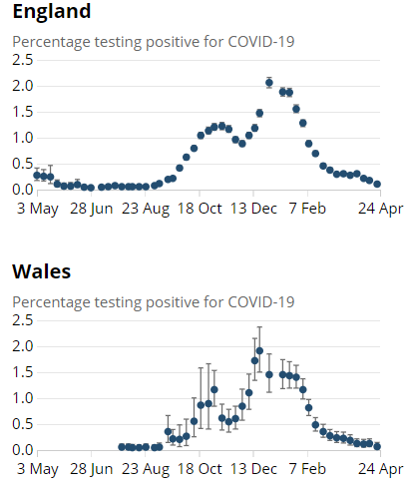
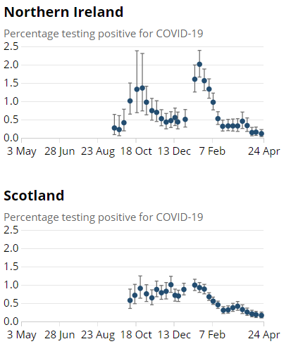
ONS infection survey data (24/04/21)
Highlight:
Latest ONS infection survey data runs up to 24 April and shows a fall in cases in all home nations.
Nation | Estimated pop with Covid | Previous week
England | 54,200 | 90,000
Wales | 1,900 | 3,600
Scotland | 8,200 | 9,300
N Ireland | 1,900 | 2,800
Source: ONS COVID-19 Infection Survey

Slide 5
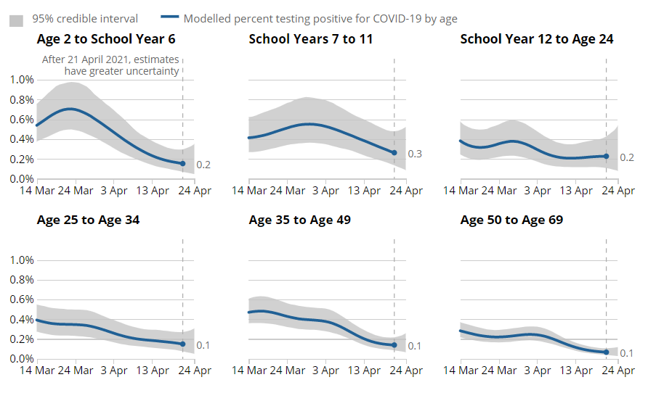
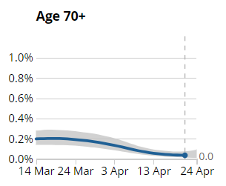
Infections by age group (England)
Estimated % of population testing positive for COVID by age group
Highlight:
Infection rates have decreased across age groups two years to school Year 11 and those aged 35 years and over. For those in school Year 12 to aged 34 years, the trend is uncertain in the week ending 24 April 2021.
Source: ONS COVID-19 Infection Survey

Slide 6
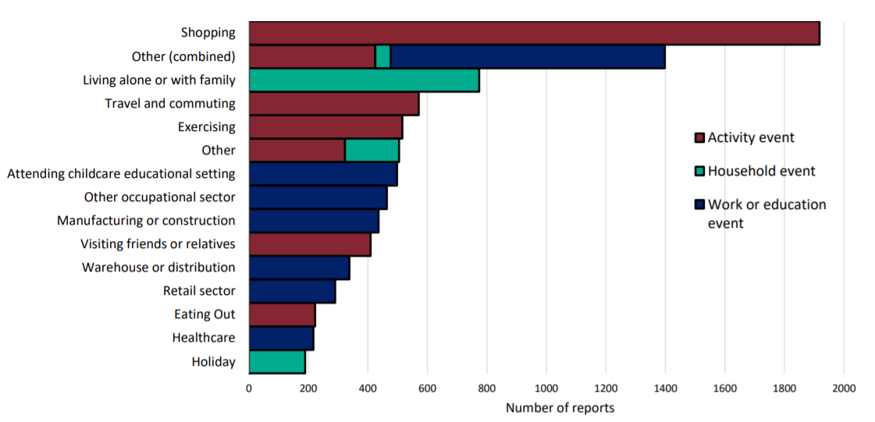
Community surveillance, England
Highlight:
This data suggests that most transmissions continue to occur while ‘shopping’.
There appears to be an overall decrease in the number of reports; for example, in week 12, there were over 5000 reports indicated for shopping, compared to under 2,000 reported in week 16.
Events and activities reported by people testing positive, prior to symptom onset, week 16
Source: National flu and COVID-19 surveillance graph

Slide 7
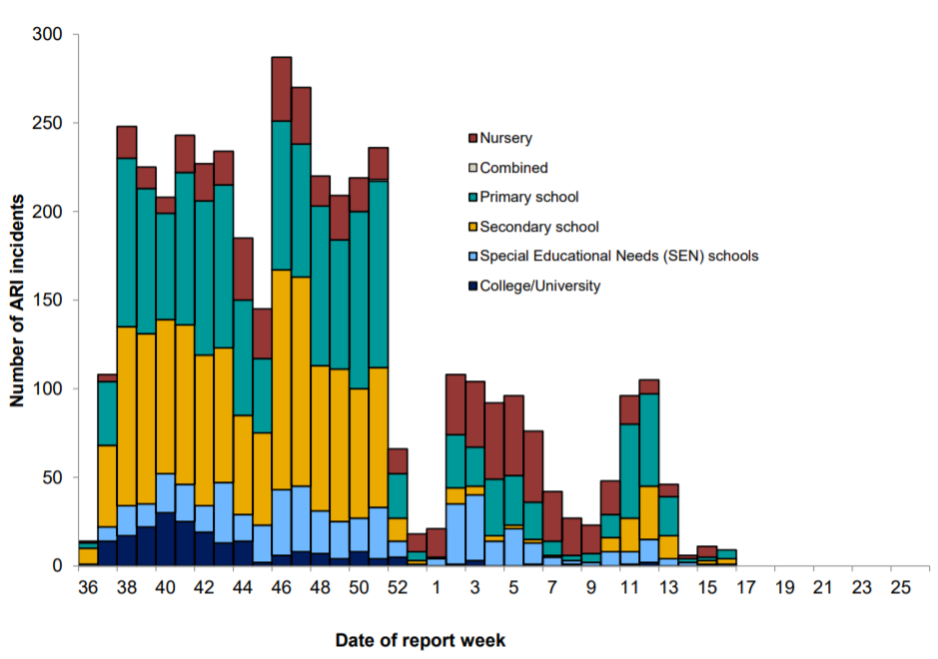
Community surveillance, England
Highlight:
The number of cases reported have very slightly increased since schools reopened on 19 April, but are still substantially lower compared to the figures reported at the start of the year.
Number of ARI incidents or outbreaks by type of educational setting, England.
Source: National flu and COVID-19 surveillance graph

Slide 8
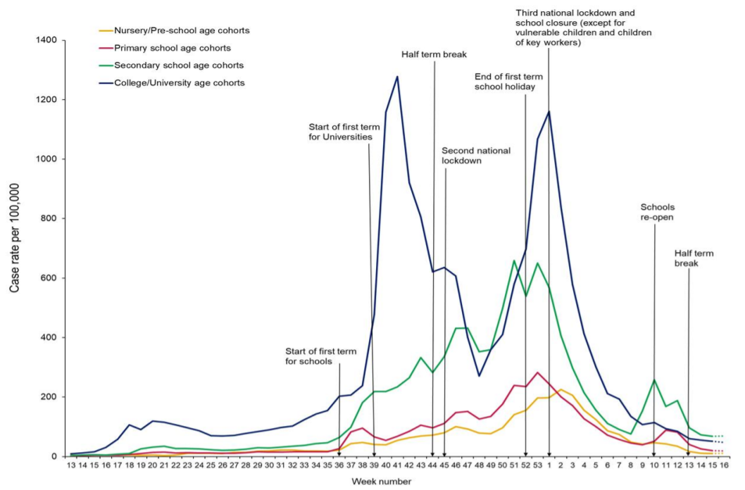
Community surveillance, England
Highlight:
Cases are levelling out across people in nursery, primary school, secondary school and college / university cohorts – this is unsurprising given the easter break.
The reported number of cases for certain age cohorts, namely students in nursery/preschool, primary and college/university,
appear to be similar to the number of confirmed cases seen over the summer.
Weekly incidence of lab confirmed Covid-19 cases per 100,000 in nursery, primary school, secondary school and college/university cohorts
Source: National flu and COVID-19 surveillance graph

Slide 9
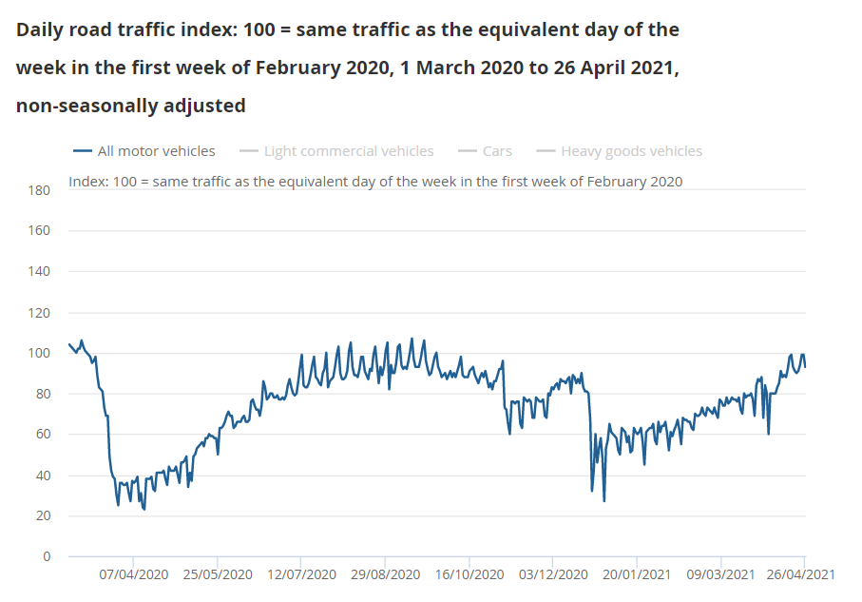
Daily road traffic
Highlight:
Road traffic remains lower than would be expected at this time of year (around 93%), but is the highest level seen since mid October 2020. Activity continues to grow as we ease out of lockdown.
Source: ONS, Coronavirus and the latest indicators for the UK economy and society

Slide 10
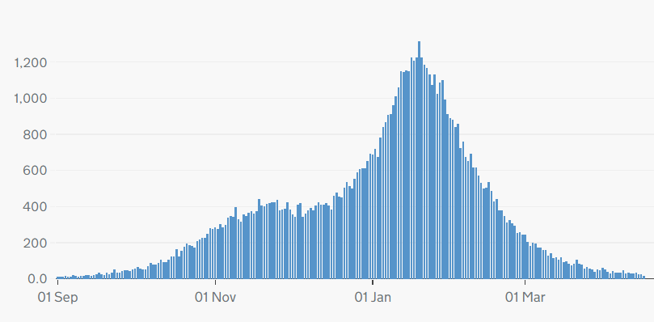
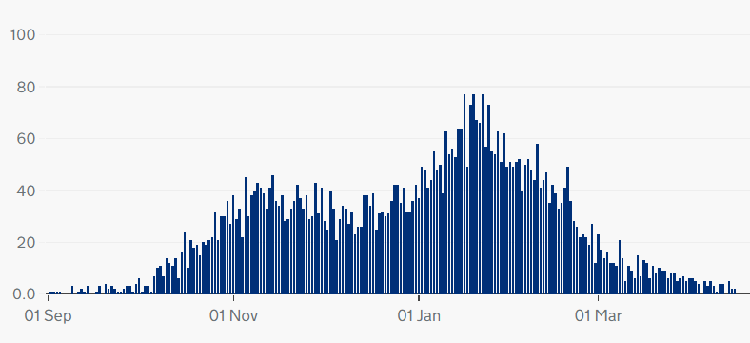
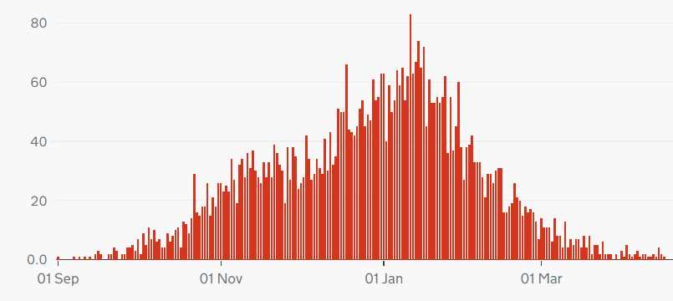
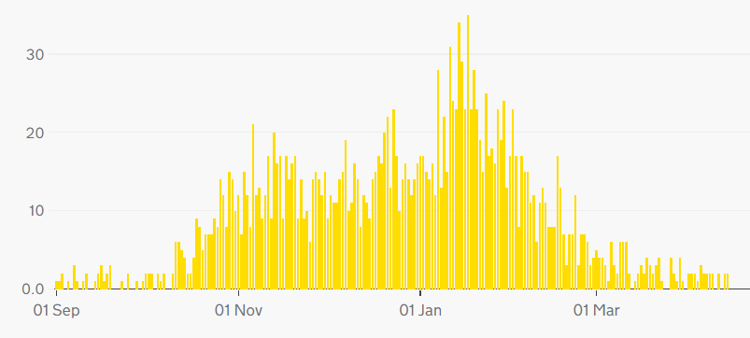
COVID-19 deaths, UK
Highlight:
The number of deaths caused by Covid-19 continue to fall across the Home Nations.
Note: different scales – but overall trend similar across nations
Cumulatively, as of 16 April, 151,243 people have died of COVID-19 in the UK.
Daily deaths with COVID-19 on the death certificate by date of death
England
Scotland
Wales
Source: Gov.uk COVID-19 dashboard

Slide 11
COVID deaths – age breakdown (England and Wales)
Highlight:
New graph – deaths per 100,000 continue to fall in the key 85+ and 75-84 age groups, and remain low in other age groups
Source: ONS, Deaths registered weekly in England and Wales, provisional

Slide 12
Excess deaths, England
Highlight:
Excess deaths have been falling over April. Latest figures for the week ending 16 April indicate that there have been 95,739 excess deaths since March 2020.
Excess deaths = registered deaths – expected deaths
Source: PHE, Excess mortality in England

Slide 13
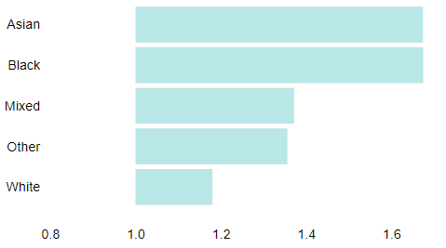
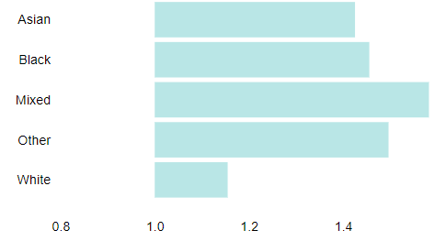
Excess deaths by ethnicity
Highlight:
The ratio of registered deaths to expected deaths is much higher among men and women of Asian and Black ethnicities compared to deaths in White groups.
Ratio of registered deaths to expected deaths for ethnic groups
in England 1 Mar 2020 – 9 Apr 2021:
Males
Females
Source: PHE, Excess mortality in England

Slide 14
Critical care bed capacity (England)
Adult critical care bed numbers and occupation levels, winter 2020 and 2021 comparison
Highlight:
The number of critical care beds open in England has been steadily falling since January, but continues to be higher than the equivalent months last year.
Source: Urgent and Emergency Care Daily Situation Reports 2020-21

Slide 15
Hospitalisations
Patients in hospital with COVID-19, UK
Highlight:
Hospitalisations have continued to fall since the recent peak in mid-January but remain slightly higher than the summer.
As of 24 April there were 1,665 people in hospital with COVID-19, with 231 patients in mechanical ventilation beds. The 7-day rolling average is below what it was at the height of the first wave, and below the level seen at the beginning of the second and third waves.
Patients with COVID-19 in mechanical ventilation beds, UK
Source: Gov.uk COVID-19 dashboard

Slide 16
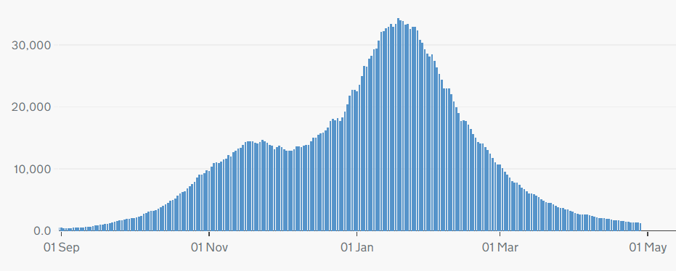
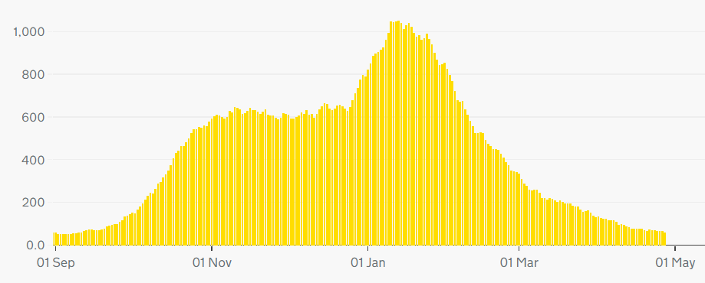
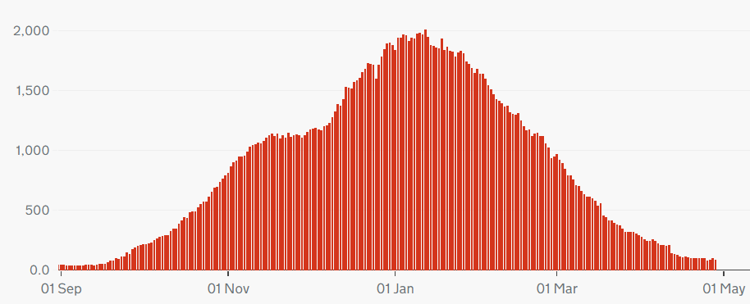
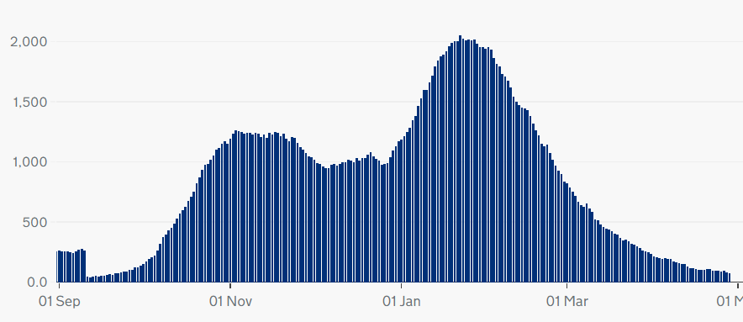
Hospitalisation trends across the UK
Highlight:
Note different scales – but overall trend similar across UK nations
England
Northern Ireland
Wales
Scotland
Source: Gov.uk COVID-19 dashboard

Slide 17
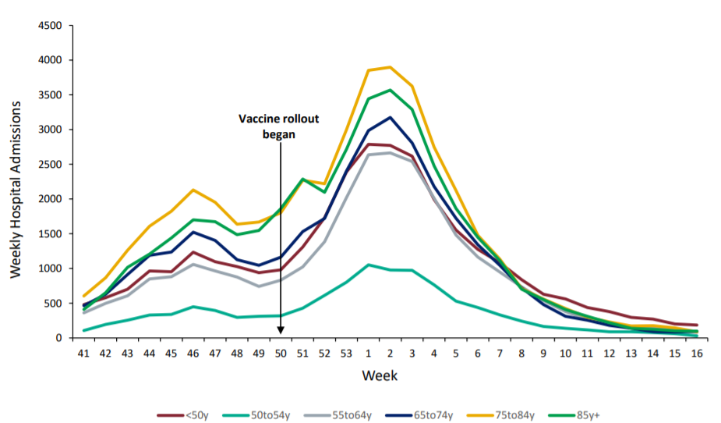
Hospital admissions by age
Weekly hospital admissions by age group
Highlight:
Hospital admissions for all age groups continue to remain low.
Source: National flu and COVID-19 surveillance report

Slide 18
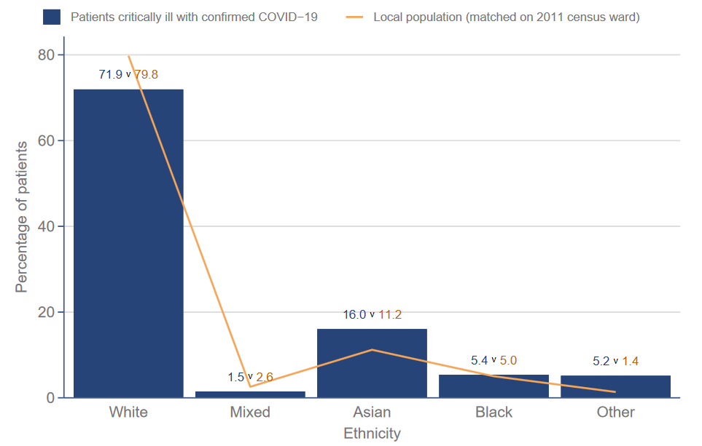
ICNARC data - ethnicity
Ethnicity distribution compared to local population - patients critically ill with COVID-19 admitted from 1 Sept 2020
Highlight:
Data from the Intensive Care National Audit and Research Centre (ICNARC) shows that those from Asian and Black ethnic backgrounds make up a disproportionate percentage of patients critically ill with COVID-19 (compared to the proportion of Asian and Black people in local populations)
Source: ICNARC report on COVID-19 in critical care (UK)

Slide 19
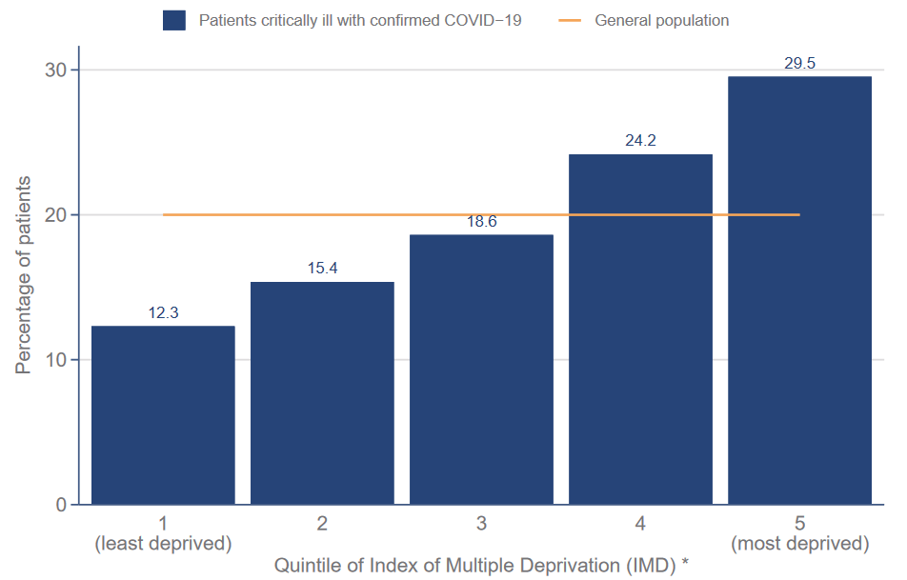
ICNARC data -deprivation
Index of Multiple Deprivation – distribution of patients critically ill with COVID-19 admitted since 1 September compared with general population
Highlight:
ICNARC data on deprivation shows those from more deprived backgrounds make up a disproportionate percentage of patients critically ill with COVID-19
Source: ICNARC report on COVID-19 in critical care (UK)

Slide 20
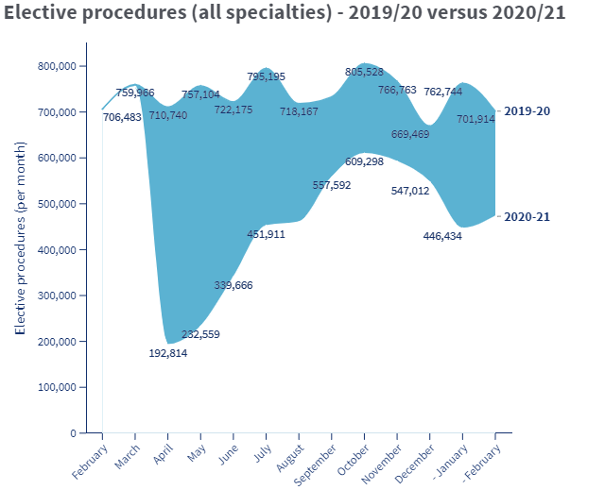
Non-COVID Backlog, England
Highlight:
New activity data for February and March shows a continued disruptive impact of Covid 19 on NHS elective care.
The BMA estimates that between April 2020 and February 2021 there were:
- 3.24 million fewer elective procedures
20.07 million fewer outpatient attendances.
Next update: May 13
Source: BMA analysis of NHS Digital Hospital Episode Statistics for Admitted Patient Care and Outpatient Data

Slide 21
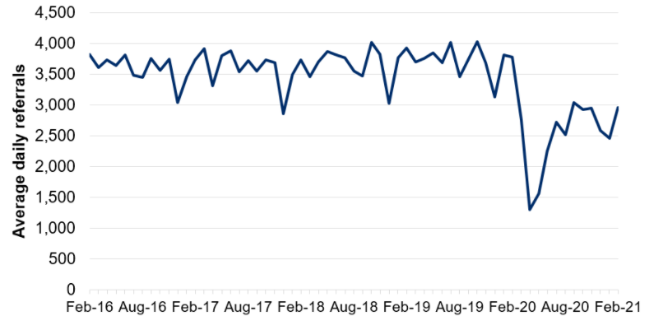
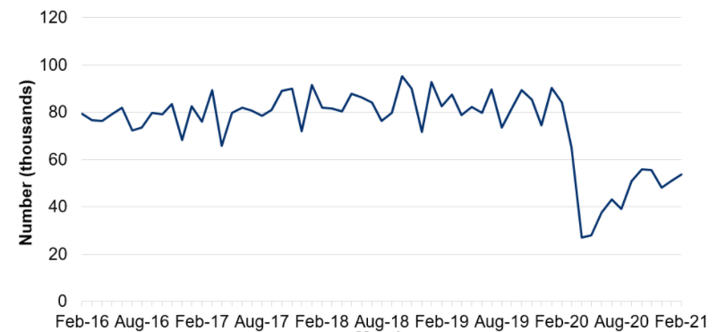
NHS pressures: Wales
Average daily number of referrals for first outpatient appointments
Highlight:
COVID-19 has caused considerable disruption to non-COVID care in Wales.
The number of referrals for first out-patients appointments fell sharply in the initial months of the pandemic before recovering to around 75% of expected levels over the summer of 2020. They fell again during January 2021.
The number of patient pathways open also fell sharply during the initial months of the pandemic before starting to recover.
Next update: 20 May 2021
Number of closed patient pathways
Source: Gov.wales, NHS activity and performance summary

Slide 22
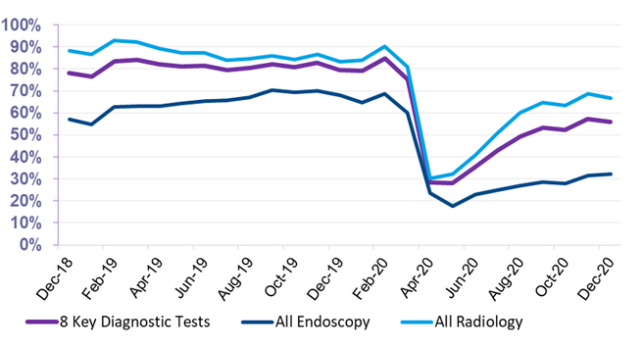
NHS pressures – Scotland
Total Number of scheduled elective operations in theatre system
Highlight:
Scheduled elective operations in the NHS in Scotland reduced sharply at the beginning of the pandemic before recovering slightly over the summer, and beginning to fall again towards the end of 2020. The latest data for Feb 2021 shows a very slight increase in the number of scheduled operations, indicating a remobilisation of elective care.
Since March 2020, there have been 157k fewer elective operations than would normally be expected (based on 2019 trends).
Next update: May 2021
The number of patients waiting 6 weeks or less fell sharply at the beginning of the pandemic, with partial recovery over the rest of 2020
Source: Public Health Scotland, Cancelled planned operations
Percentage of patients waiting 6 weeks or less at month end, split by test type
Source: Public Health Scotland, NHS waiting times - diagnostics

Slide 23
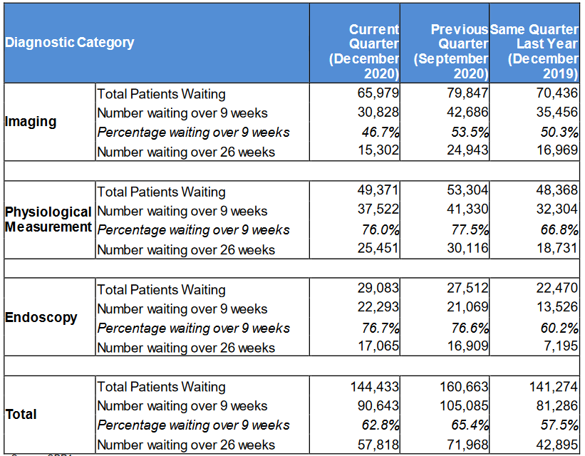
NHS pressures – Northern Ireland
Highlight:
COVID-19 has affected waiting times for diagnostic services in Northern Ireland
The number of patients waiting over 9 weeks and over 26 weeks both rose in the Quarter up to September 2020, reflecting the disruption to services seen during the initial phases of the pandemic
Waiting times have recovered somewhat in the Quarter ending December 2020, but remain higher than the same Quarter in 2019
Source: Northern Ireland waiting time statistics: diagnostic waiting times

Slide 24
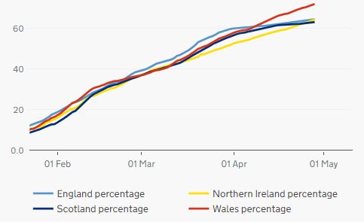
Cumulative vaccination coverage by nation
First Dose Coverage for the Home Nations: Jan 10 – April 29
Highlight:
As of 29 April, 34,094,048 people in the UK had received their first vaccine.
There are small disparities in coverage seen across the nations, with Wales having vaccinated almost three quarters of its eligible population.
- 64.5%
- 64.4%
- 63.1%
- 72%
Source: Gov.uk, Vaccinations in United Kingdom

Slide 25
Vaccination coverage, UK
Number of vaccinations given across the UK: Jan 10 – April 28
Highlight:
The last few weeks have continued to see a higher level of administration of second doses compared to first doses.
The total number of vaccines administered are not quite as high as the levels seen in March, but progress is being made.
Source: Gov.uk, Vaccinations in United Kingdom (BMA graph)

Slide 26
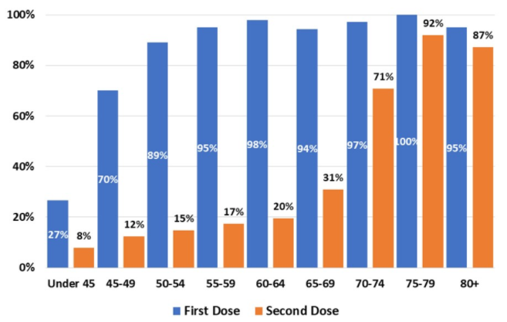
Vaccination coverage by age group, England
Proportion of population vaccinated by age group, England
Highlight:
Latest NHSE data covers vaccinations up to 25 April.
Rate of delivery remains high, with almost 90% of the over 50’s having received a first dose, while 92% of 75-79 year olds have received their second dose.
With the Government inviting all over 40’s to book their Covid Vaccination appointment, the age brackets will continue to expand for this graph.
Data source: NHS England, Covid 19 Vaccination

