Slide 1
Weekly Covid-19 data update
26/03/2021
Contact: Jon Ware, Head of Health Policy
jware@bma.org.uk

Slide 2
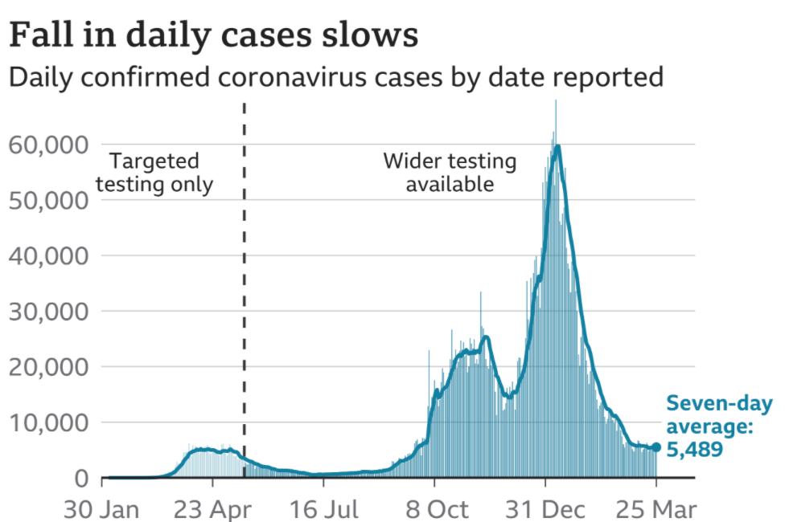
Cases – UK wide
Highlight:
There were 6,397 confirmed cases across the UK reported on 25 March, compared to 6,303 the week before.
The seven-day average indicates that the number of cases appear to be reaching a plateau, with a reduction in the rate at which they were falling over the last weeks. Cases still appear to be substantially higher than in the summer.
Source: Gov.uk COVID-19 dashboard (graph via BBC)

Slide 3
Cases by nation (and English regions)
Highlight:
Cases have been falling across England, Scotland, Wales and Northern Ireland, but the rate of decrease has reduced and appears to be levelling out. Cases are still falling across English regions, although with considerable variation in cases per 100k between different areas. In Yorkshire and The Humber, cases have slightly risen again this week.
Cases per 100,000 by nation, last 7 days
Cases per 100,000 by English region, last 7 days
English Region | Cases per 100k | % Change compared to last week
Yorkshire and The Humber | 109.1 | +1.4%
East Midlands | 75.8 | -3.9%
North East | 70.4 | -10%
North West | 68.8 | -7.9%
West Midlands | 65.1 | -2.3%
East of England | 42.5 | -4.1%
London | 35.8 | -8.4%
South East | 33.9 | -6.9%
South West | 28.4 | -8.4%
Source: Gov.uk COVID-19 dashboard (BMA graph)

Slide 4
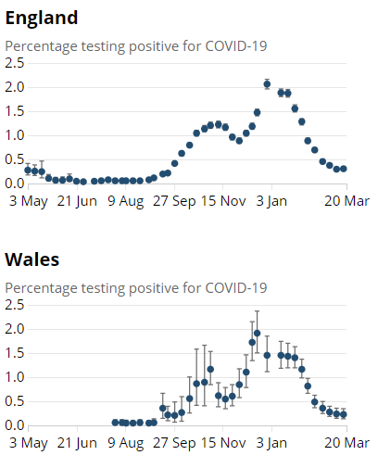
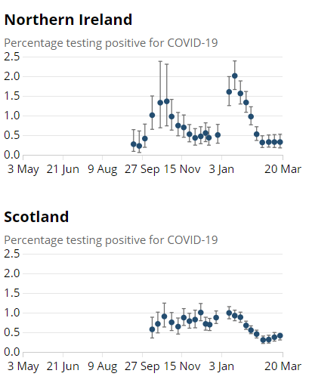
ONS infection survey data (20/03/21)
Highlight:
Latest ONS infection survey data runs up to 20 March and continues to show a slight fall in cases in Wales with a plateau in Northern Ireland. Cases appear to be increasing in Scotland and may be beginning to increase again in England.
Nation | Estimated pop with Covid | Previous week
England | 162,500 | 160,200
Wales | 6,700 | 7,000
Scotland | 21,500 | 19,300
N Ireland | 5,800 | 5,800
Source: ONS COVID-19 Infection Survey

Slide 5
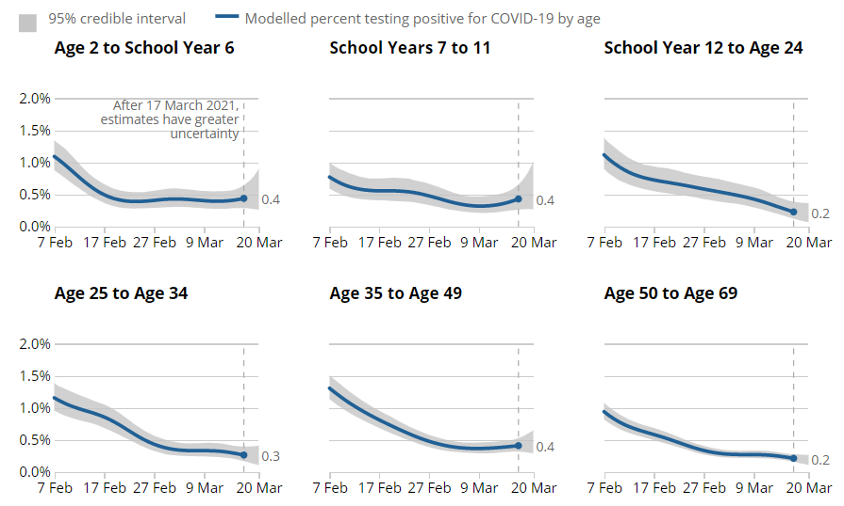
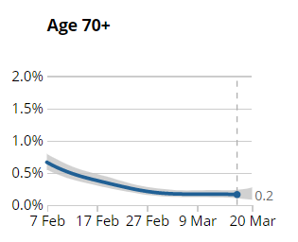
Infections by age group (England)
Estimated % of population testing positive for COVID by age group
Highlight:
Infection rates across age groups have been falling, but in recent weeks appear to be rising again in some groups, with schools years 7 to 11 in particular seeing a rise. This likely reflects increased contact due to schools returning to-face-face teaching
Source: ONS COVID-19 Infection Survey

Slide 6
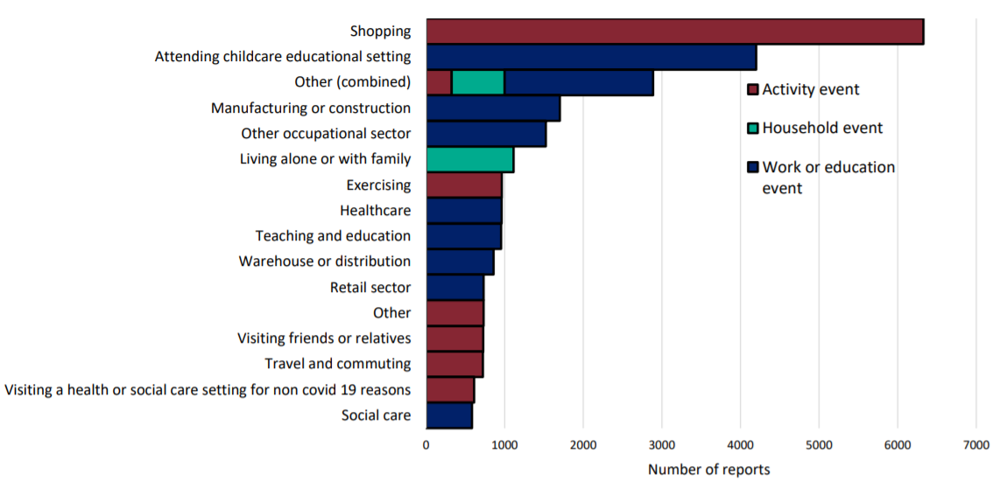
Community surveillance, England
Events and activities reported by people testing positive, prior to symptom onset, week 11
Highlight:
Significant increase in people who have tested positive reporting “attending childcare educational setting” as a recent activity– unsurprising given recent return to face-to-face schooling
Source: National flu and COVID-19 surveillance graph

Slide 7
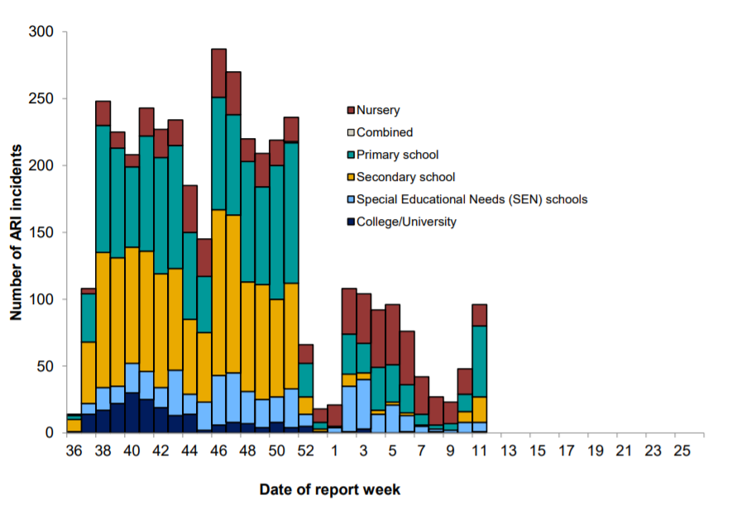
Community surveillance, England
Highlight:
This week there has been a notable increase in outbreaks across primary schools, with a slight increase in the number of incidents seen across secondary schools. The increase in outbreaks seen in week 11 corresponds with the opening of schools at the start of week 10.
Number of ARI incidents or outbreaks by type of educational setting, England.
Source: National flu and COVID-19 surveillance graph

Slide 8
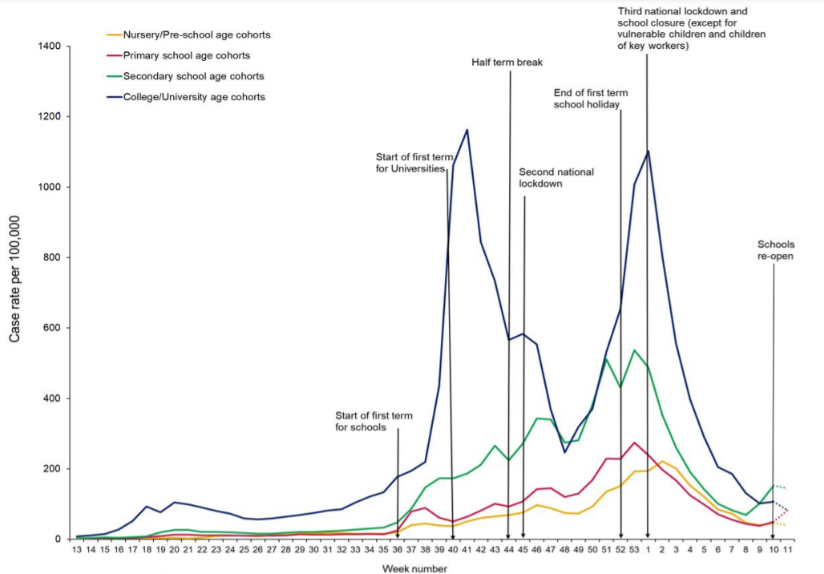
Community surveillance, England
Highlight:
Cases continue to fall across people in nursery, and college/ university cohorts in week 11 of 2021. However, there has been a rise in cases reported for primary schools.
While there are a low number of cases reported overall, figures appear to be higher than number reported a few weeks ago, and higher than the number of confirmed cases seen over the summer.
Weekly incidence of lab confirmed Covid-19 cases per 100,000 in nursery, primary school, secondary school and college/university cohorts
Source: National flu and COVID-19 surveillance graph

Slide 9
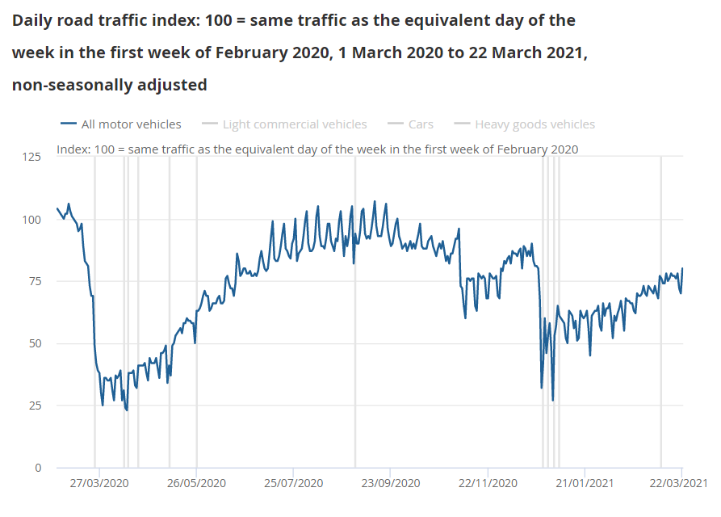
Daily road traffic
Highlight:
Road traffic remains lower than would be expected at this time of year (around 80%). There is more road activity than in the first wave but less than the second wave. Activity continues to grow in recent weeks
Source: ONS, Coronavirus and the latest indicators for the UK economy and society

Slide 10
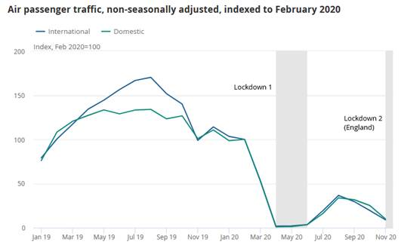
Air traffic
Highlight:
Air traffic at UK airports dropped sharply at the beginning of the pandemic before recovering slightly over the summer of 2020. They have been falling again since August/September and remain at a relatively low level compared to the Feb 2020 baseline.
Source: ONS, Coronavirus and the impact on the UK travel and tourism industry

Slide 11
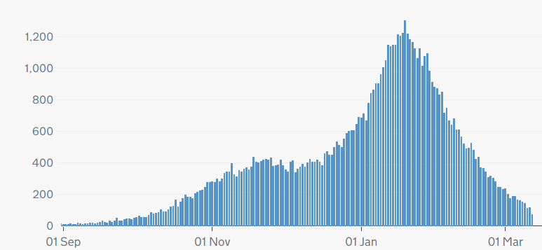
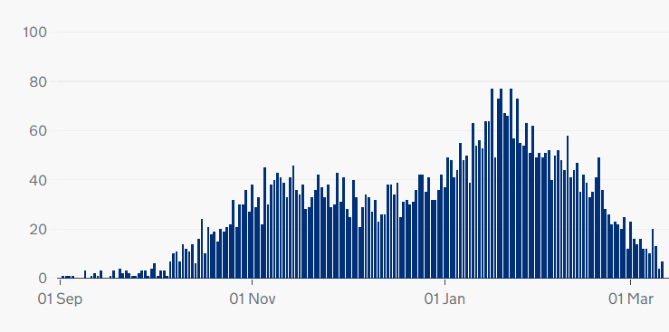
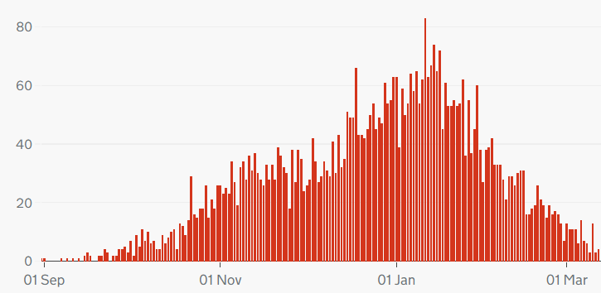
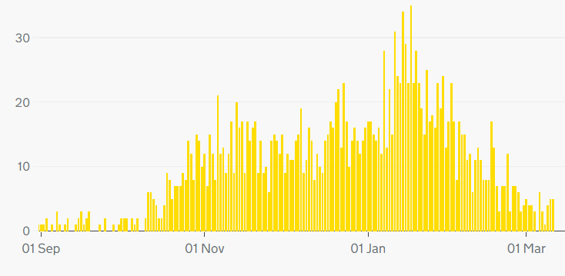
COVID-19 deaths, UK
Highlight:
Deaths continue to fall across the UK although figures for NI suggest a slight increase in recent days.
Cumulatively as of 12 Mar 148,125 people have died of COVID-19 in the UK.
Daily deaths with COVID-19 on the death certificate by date of death
England
Scotland
Wales
Northern Ireland
Source: Gov.uk COVID-19 dashboard

Slide 12
COVID deaths – age breakdown (England and Wales)
Highlight:
New graph – deaths per 100,000 continue to fall in the key 85+ and 75-84 age groups, and remain low in other age groups
Source: ONS, Deaths registered weekly in England and Wales, provisional

Slide 13
Excess deaths, England
Highlight:
Excess deaths have been falling over March. There have been 101,825 excess deaths since March 2020.
Source: PHE, Excess mortality in England

Slide 14
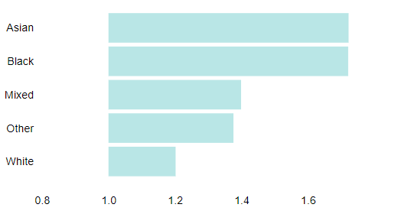
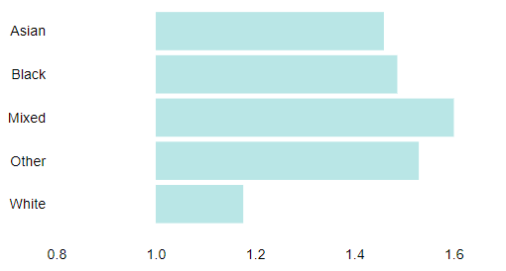
Excess deaths by ethnicity
Highlight:
The ratio of registered deaths to expected deaths is much higher amongst people of Asian, Black and Mixed ethnicity.
Ratio of registered deaths to expected deaths for ethnic groups
in England 27 Mar 2020 - 6 Mar 2021:
Males
Females
Source: PHE, Excess mortality in England

Slide 15
Critical care bed capacity (England)
Adult critical care bed numbers and occupation levels, winter 2020 and 2021 comparison
Highlight:
The number of critical care beds open in England has been steadily falling since January, but continues to be higher than the equivalent months last year.
Source: Urgent and Emergency Care Daily Situation Reports 2020-21

Slide 16
Hospitalisations
Patients in hospital with COVID-19, UK
Highlight:
Hospitalisations have continued to fall since the recent peak in mid-January but remain higher than the summer.
As of 23 March there were 5,122 people in hospitals with COVID-19. The 7-day rolling average is below what it was at the height of the first wave, and below the level seen at the beginning of the second and third waves.
Patients with COVID-19 in mechanical ventilation beds, UK
Source: Gov.uk COVID-19 dashboard

Slide 17
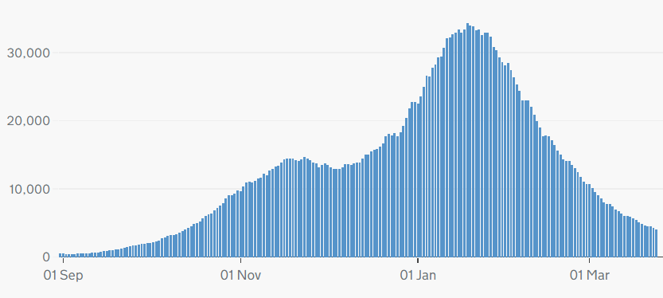
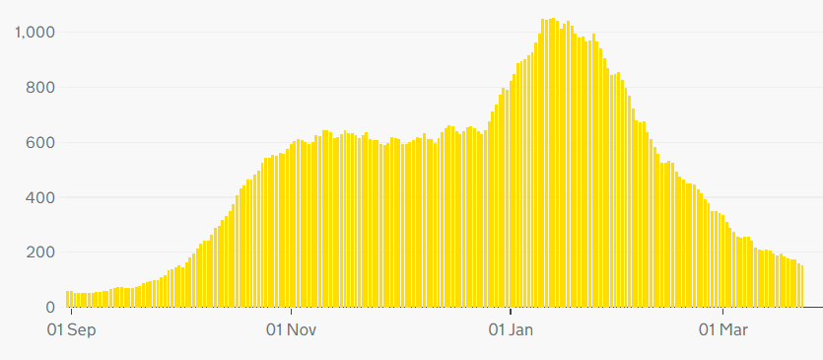
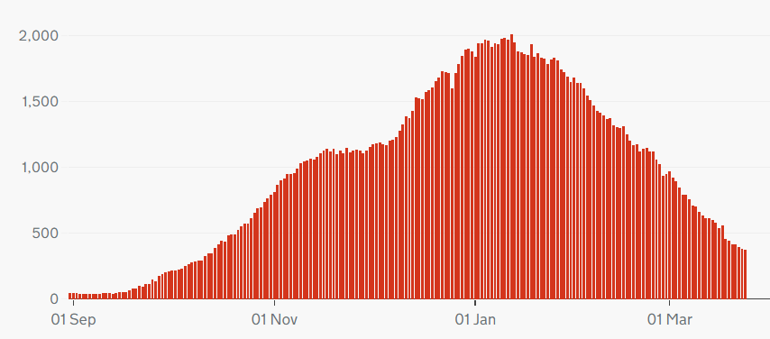
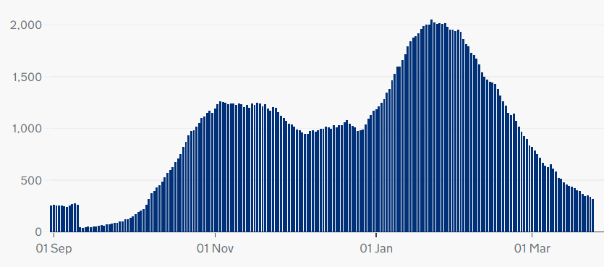
Hospitalisation trends across the UK
Highlight:
Note different scales – but overall trend similar across UK nations
England
Northern Ireland
Wales
Scotland
Source: Gov.uk COVID-19 dashboard
Notes:
H – graphs updated.

Slide 18
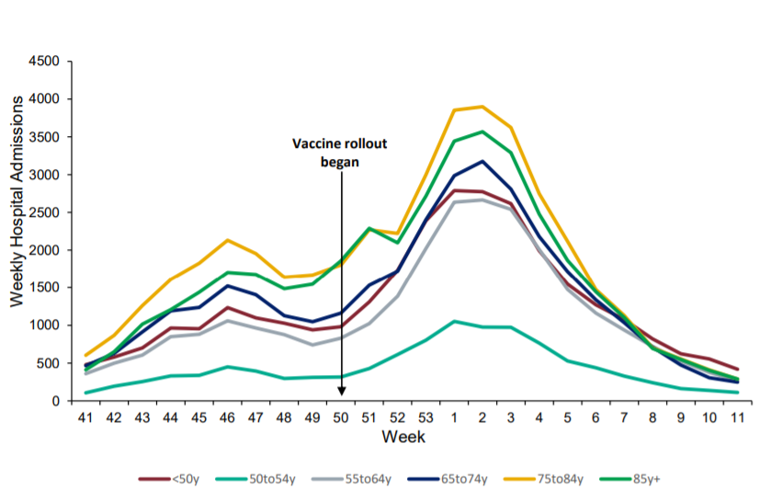
Hospital admissions by age
Weekly hospital admissions by age group
Highlight:
Hospital admissions for all age groups continue to fall.
Source: National flu and COVID-19 surveillance report
Notes:
H – can’t find the same chart as last week but have added the nearest thing I could find next to it (slide 57 in second report listed). Please check & see if ok replacement.

Slide 19
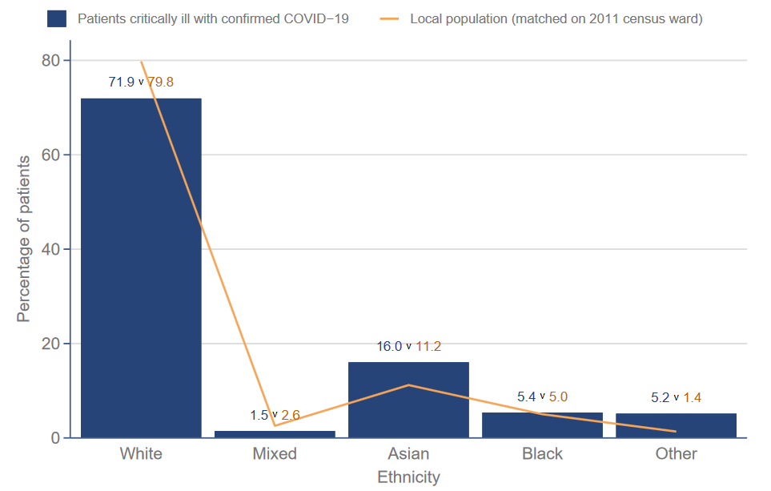
ICNARC data - ethnicity
Ethnicity distribution compared to local population - patients critically ill with COVID-19 admitted from 1 Sept 2020
Highlight:
Data from the Intensive Care National Audit and Research Centre (ICNARC) shows that those from Asian and Black ethnic backgrounds make up a disproportionate percentage of patients critically ill with COVID-19 (compared to the proportion of Asian and Black people in local populations)
Source: ICNARC report on COVID-19 in critical care (UK)

Slide 20
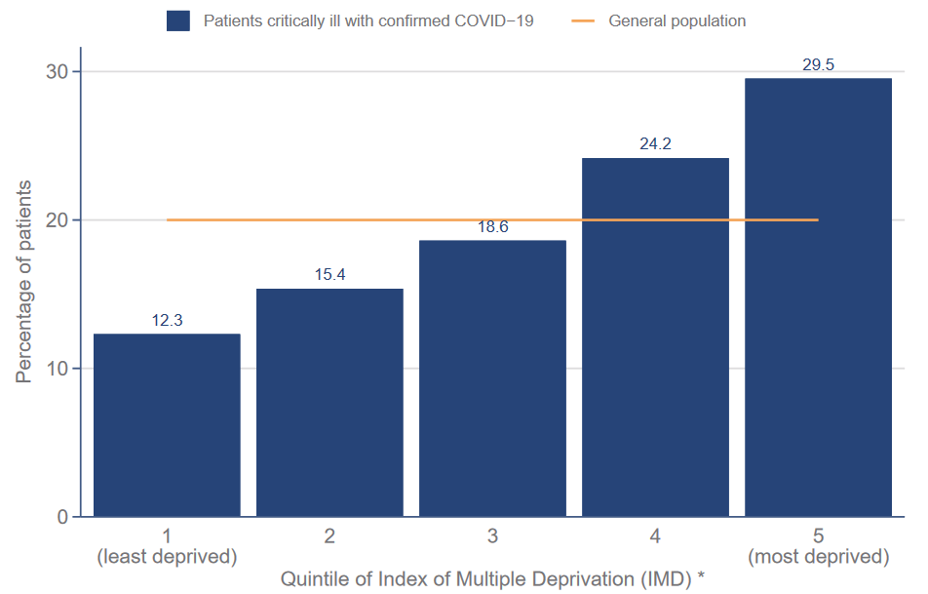
ICNARC data -deprivation
Index of Multiple Deprivation – distribution of patients critically ill with COVID-19 admitted since 1 September compared with general population
Highlight:
ICNARC data on deprivation shows those from more deprived backgrounds make up a disproportionate percentage of patients critically ill with COVID-19
Source: ICNARC report on COVID-19 in critical care (UK)

Slide 21
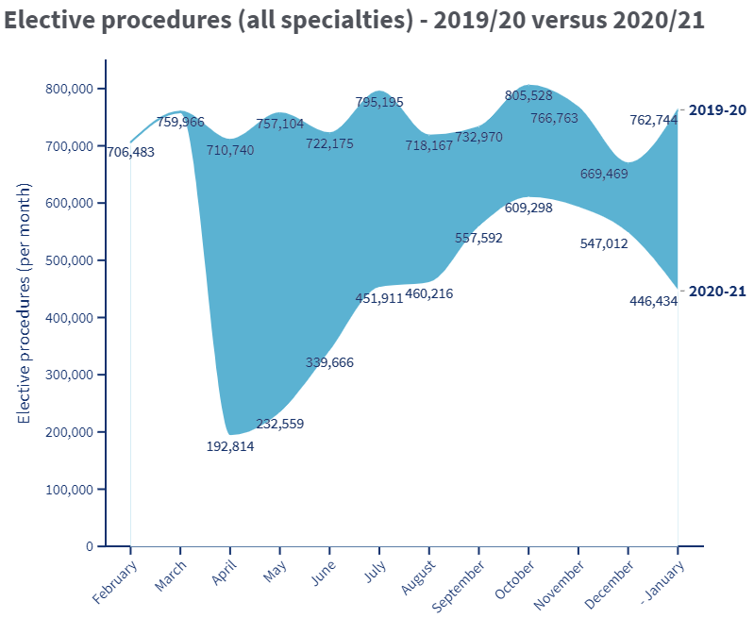
Non-COVID Backlog, England
Highlight:
The data for January shows a significant drop in elective activity in England as hospitals focused on COVID-19
The BMA estimates that between April 2020 and January 2021 there were:
3 million fewer elective procedures
21 million fewer outpatient attendances
Next update: 15 April
Source: BMA analysis of NHS Digital Hospital Episode Statistics for Admitted Patient Care and Outpatient Data

Slide 22
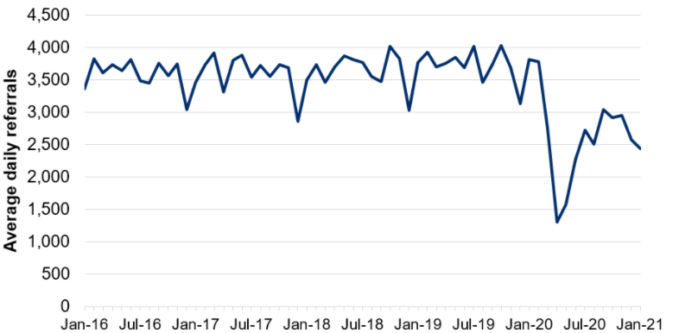
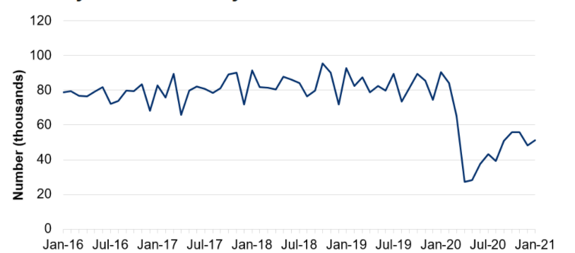
NHS pressures: Wales
Average daily number of referrals for first outpatient appointments
Highlight:
COVID-19 has caused considerable disruption to non-COVID care in Wales.
The number of referrals for first out-patients appointments fell sharply in the initial months of the pandemic before recovering to around 75% of expected levels over the summer of 2020. They fell again during January 2021.
The number of patient pathways open also fell sharply during the initial months of the pandemic before starting to recover.
Next update: 22 April 2021
Number of closed patient pathways
Source: Gov.wales, NHS activity and performance summary

Slide 23
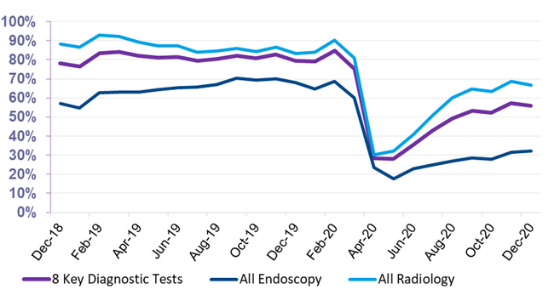
NHS pressures – Scotland
Total Number of scheduled elective operations in theatre system
Highlight:
Scheduled elective operations in the NHS in Scotland reduced sharply at the beginning of the pandemic before recovering slightly over the summer, and beginning to fall again towards the end of 2020. The latest data for Jan 2021 shows a further dip as NHS Scotland dealt with high numbers of COVID-19 patients.
Since March 2020, there have been 143k fewer elective operations than would normally be expected (based on 2019 trends). Next update 6 April.
The number of patients waiting 6 weeks or less fell sharply at the beginning of the pandemic, with partial recovery over the rest of 2020
Source: Public Health Scotland, Cancelled planned operations
Percentage of patients waiting 6 weeks or less at month end, split by test type
Source: Public Health Scotland, NHS waiting times - diagnostics

Slide 24
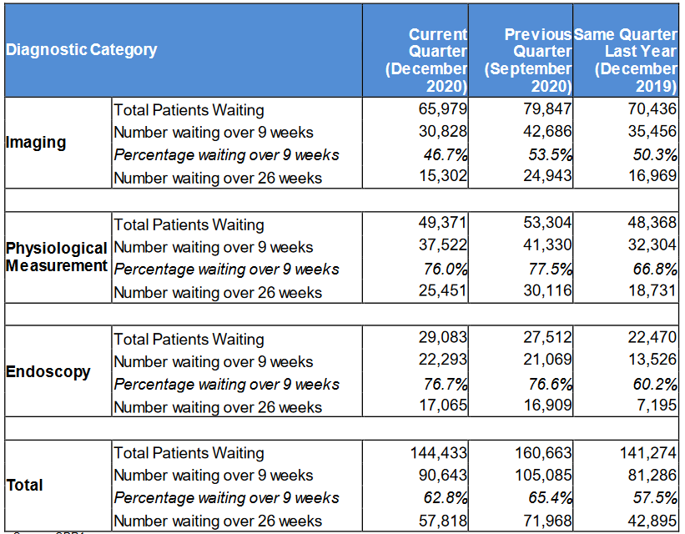
NHS pressures – Northern Ireland
Highlight:
COVID-19 has affected waiting times for diagnostic services in Northern Ireland
The number of patients waiting over 9 weeks and over 26 weeks both rose in the Quarter up to September 2020, reflecting the disruption to services seen during the initial phases of the pandemic
Waiting times have recovered somewhat in the Quarter ending December 2020, but remain higher than the same Quarter in 2019
Source: Northern Ireland waiting time statistics: diagnostic waiting times

Slide 25
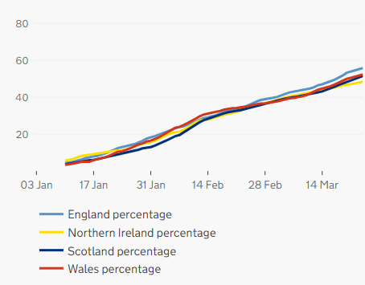
Cumulative vaccination coverage by nation
Highlight:
Until the 24th of March, 28,991,188 people in the UK had received their first vaccine.
Approximately half of the population in the UK have received their first dose of vaccination, although there is a small disparity between the nations.
- 55.8%
- 48.4%
- 51.5%
- 52.3%
Source: Gov.uk, Vaccinations in United Kingdom

Slide 26
Vaccination coverage, UK
Highlight:
Note: The weekly tables run up to 24 March.
Last week has seen an increase in the number of people receiving their first and second vaccinations across the UK.
As we move into April, we will begin to see a fall in the number of first doses but an increase in the number of second doses due to supply issues.
Source: Gov.uk, Vaccinations in United Kingdom (BMA graph)

Slide 27
Vaccination coverage by age group, England
Highlight:
Latest NHSE data covers vaccinations up to 21 March.
Coverage is high, with more than 90% of the over 60s having received their first dose, and an increase in the number of over 80’s receiving their second.
Proportion of population vaccinated by age group, England

Slide 28
Vaccine uptake among estimated number of NHS frontline staff, England
Region | As of 21 February | As of 28 February | As of 7 March | As of 14 March | As of 21 March
North East And Yorkshire | 97% | 98.50% | 100% | 100%* | 100%*
South West | 96% | 98.10% | 99.60% | 100%* | 100%*
East Of England | 94% | 96.20% | 97.60% | 98.95% | 100%*
South East | 94% | 96% | 97.50% | 99.16% | 100%*
North West | 94% | 96% | 97.60% | 99.47% | 100%*
Midlands | 91% | 93.30% | 95.10% | 96.64% | 98.00%
London | 76% | 78.70% | 80.80% | 82.88% | 85.00%
Highlight:
Latest NHSE vaccination data indicates that all regions, with the exception of London and the Midlands have vaccinated 100% of frontline workers.
The uptake in London continues to steadily increases by approximately 2 percentage points week by week.
Source: NHS England, Vaccinations Statistics (BMA table)

