Slide 1
Viral Hepatitis C in Dudley
Dr. Mamoona Tahir
Consultant in Communicable Disease Control
Viral Hepatitis lead
PHE West Midlands

Slide 2
Overview
Why should we be concerned about Liver disease & Hepatitis C
Hepatitis C Commissioning
Epidemiology of Hepatitis C in Dudley
West Midlands priorities for action
Testing
Drug and sexual health services
Review of services
Summary

Slide 3
Liver disease is a major killer
Liver disease is one the 5th big killer diseases in UK
Mortality from Liver disease is increasing
Liver disease causes 6% of all premature deaths
90% of people who die from liver disease are under 70 years of age
Over 70% of patients have complex needs and die in the hospital

Slide 4
Under 75 mortality rate from liver disease
NHS Outcomes Framework 2016/17
Domain 1: Preventing People from Dying Prematurely
Public Health Outcomes Framework
Domain 4: Healthcare public health and preventing premature mortality
CCG Outcomes Indicator Set 2015/16
Domain 1: Preventing people from dying prematurely
Notes:
Diagnosing and treating people with hepatitis C will help commissioners in public health and the NHS to deliver their high level outcome to reduce health inequalities.

Slide 5
Why Hepatitis C
Hepatitis C is the commonest cause of liver disease
It is curable
Hepatitis C patients who are treated are four time less likely to be hospitalised or die of liver related causes
Hepatitis C disproportionately affects disadvantaged, vulnerable and socially excluded people, particularly homeless people, prisoners and injecting drug users
Global Hepatitis C elimination strategy

Slide 6
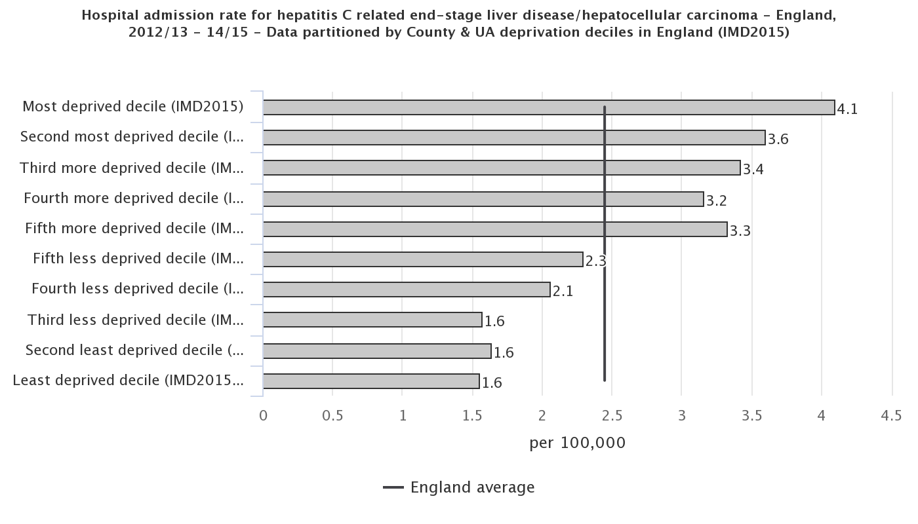
Hospital admission rate for hepatitis C related end-stage liver disease/hepatocellular carcinoma England, 2012/13 - 14/15

Slide 7
Hepatitis C -Commissioning

Slide 8
Hepatitis C –health needs
Is the local need and geographical pattern understood ?
What is the prevalence and incidence of the disease, the numbers of people with a positive test for hepatitis C against the numbers treated?

Slide 9
Directly standardised rates of testing by LA in West Midlands 2015/2016

Slide 10
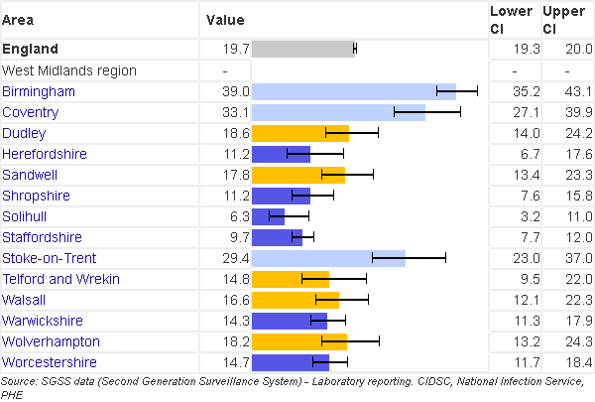
Hepatitis C detection rate/100,000

Slide 11
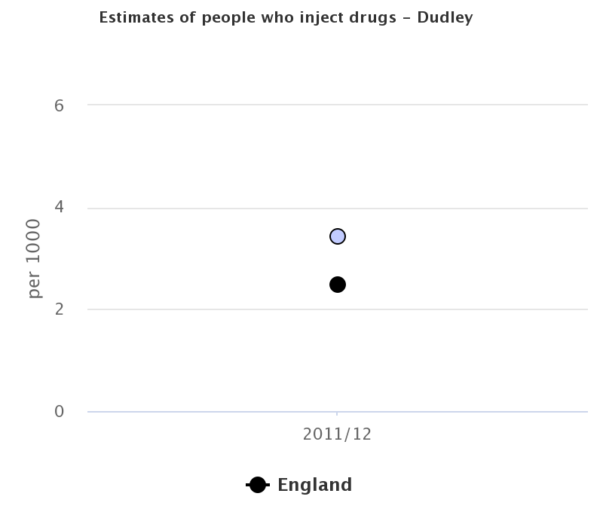

Slide 12
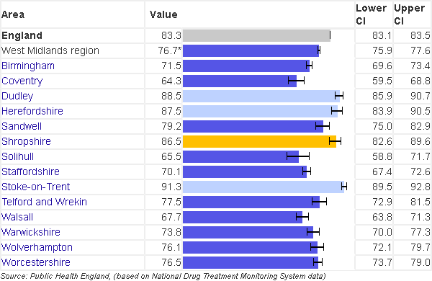
Percentage of eligible PWID in drug misuse treatment who have received a hepatitis C test in 2017

Slide 13
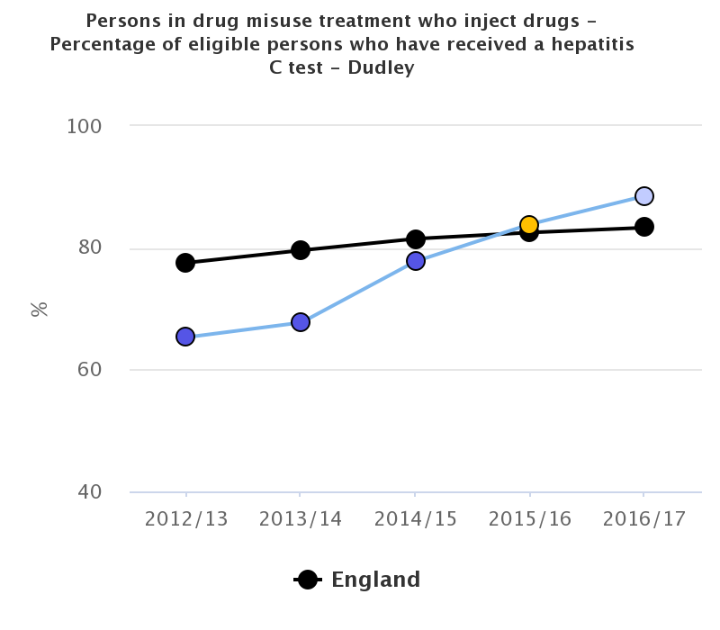

Slide 14
Dudley | Q1 |  | Q2 |  | Q3 |  | Q4
 | No. | % | No. | % | No. | % | No. | %
Offered & accepted | 24 | 55.8 | 43 | 41.3 | 79 | 48.5 | 112 | 53.6
Offered & refused | 19 | 44.2 | 61 | 58.7 | 84 | 51.5 | 97 | 46.4
Assessed as not appropriate to offer | 0 | 0.0 | 0 | 0.0 | 0 | 0.0 | 0 | 0.0
Not offered | 0 | 0.0 | 0 | 0.0 | 0 | 0.0 | 0 | 0.0
No status recorded | 0 | 0.0 | 0 | 0.0 | 0 | 0.0 | 0 | 0.0
Total | 43 |  | 104 |  | 163 |  | 209
Without a Hep C Test (of those who offered & accepted above) |  |  |  |  |  |  | 1 / 113 0.9%

Slide 15
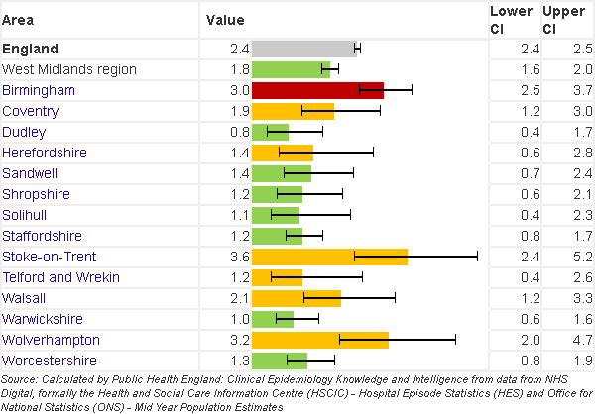
Hospital admission rate for hepatitis C related end-stage liver disease/hepatocellular carcinoma

Slide 16
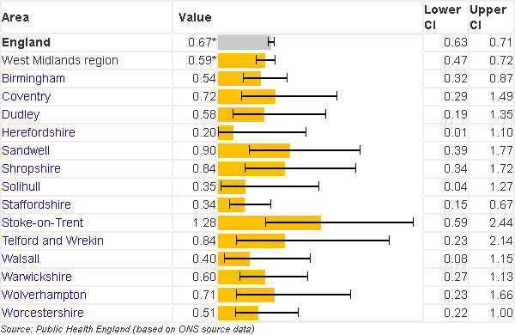
Under 75 mortality rate from hepatitis C related end-stage liver disease/hepatocellular carcinoma2014 - 16

Slide 17
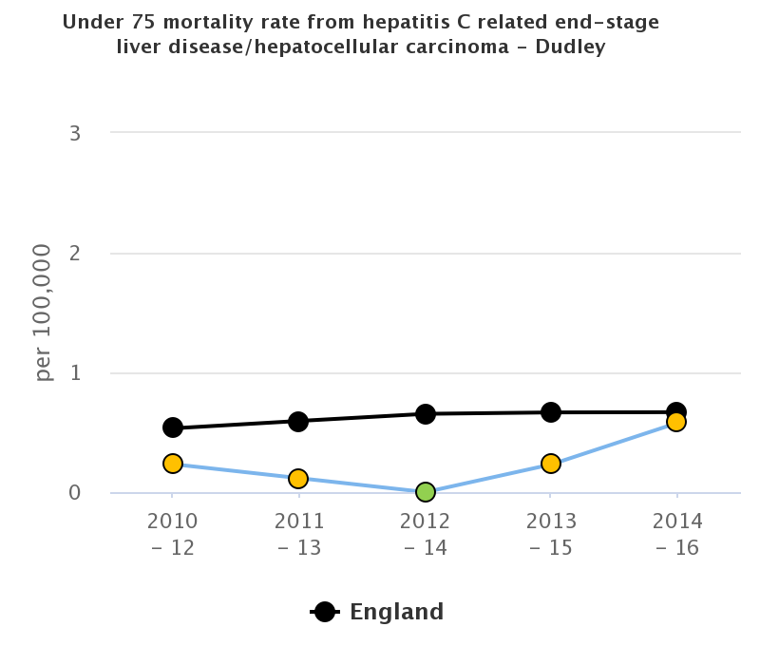

Slide 18
West Midlands Strategic priority
Case identification
Referral to treatment services-ODN Run rate
Monitoring of Drug services
Monitoring of sexual health services
Harm minimisation
Awareness raising among public and professionals

Slide 19
Testing
NICE's guidance - “Promoting and offering testing to people at increased risk of HCV infection”
People who have ever injected drugs
Prisoners, including young offenders
HIV‑positive men who have sex with men
People born or brought up in a country with a 2% or greater prevalence of chronic hepatitis C
People living in hostels for the homeless or sleeping on the streets
Children and young people living in care homes

Slide 20
Needle exchange programme
Underrepresented groups including minority ethnic group who injects
Demographic Young users <18 years age, ex prisoners, homeless, sex workers
Consulting users
Frontline workers in needle syringe programmes
Families and carers
Range of accessible
services
Pharmacies, Statutory, voluntary and private sector
Characteristics of the drug users
Poly drug use, use of performance enhancing drugs
New psychoactive drugs
Collation of information
Harm reduction Information and advice
Hepatitis C testing
Integrated care pathway
Including treatment services
Safe disposal of needle and syringes
Monitor the services
Trained & competent staff

Slide 21
Service review
Do we know what services are being provided and what the gaps are?
How can we make services more accessible to reduce the DNA rates?
Do we have the information on how many people are tested rather than offered the test?
Have the providers achieved the desired outcomes outlined in the service specification?
Do we know what are the service users and professionals views of the services?
How do the services provided match up to best practice?
Has the service been audited?

Slide 22
Some additional questions
Testing policy/pathway
Offer of test
Who is offered, How it is offered?
What is done if patient refuses? ( Any counselling pre and post test?)
What test/tests are carried out?
Where is it sent?
What is done if the test is positive?
What service is available (in-reach /outreach)
Where are patient referred to if they test positive?
What measure are taken to ensure patient attend for treatment?
What are the barriers to access to treatment?
What is the proposed solution?

Slide 23
Summary
Hepatitis C is a preventable cause of liver mortality
Epidemiology of Hepatitis C in Dudley is in line with the West Midlands/ England average
Increase in Hepatitis C testing and treatment leading to SVR
Prevention -Needle exchange/harm minimisation
Awareness raising
Consider inclusion into JSNA
Monitoring of contracts
Integrated Care pathways
Service review

