Slide 1
IR35: Where are we now?
Paul Mason
National Account Manager

Slide 2
Today’s topics
IR35: Where are we now?
Quick run through of the fundamentals of IR35
The impact of the recent consultation on employment status
What has changed in the public sector and may change in the private sector
The “CEST” Tool

Slide 3
Consultation on employment status
IR35: Where are we now?
Government favours an alignment of tax and employment rights
The “Dependent Contractor”
MOO makes a comeback!
This outcome of this consultation will have a direct impact on IR35

Slide 4
IR35: Creating the hypothetical contract
IR35: Where are we now?
End Client
Upper contract
Hypothetical contract
Agency
Lower contract
(Personal) Service Company
The Indivdual
(Shareholder/Director)

Slide 5
IR35: The issues – Ready Mixed Concrete
IR35: Where are we now?
Personal Service
Control
  What / Where / When / How
Mutuality of Obligations
Financial Risk/Business enterprise

Slide 6
For legislative purposes: what is the public sector?
IR35: Where are we now?
FOI Act 2000 (2002 Scotland) define public sector:
Government departments, legislative bodies, armed forces
Local government
NHS – NB: incl. GP Surgeries & Dental Practices, but not businesses providing ophthalmic/pharmaceutical services
Schools and further and higher education institutions
Police
Other public bodies; e.g. British Museum, BBC, Channel 4
Publically owned companies (wholly owned by the Crown and/or the wider public sector such as TfL).

Slide 7
“Redefining” the contractual chain
IR35: Where are we now?
Public sector body:
the IR35 status decision-maker (and can be ‘fee-payer’)
Agency – the agency closest in the chain to the PSC would be the ‘fee-payer’
(Personal) Service Company

Slide 8
Who determines status?
IR35: Where are we now?
  Key change: public body is IR35 decision-maker
There is no right of appeal against the decision
“Ultimately, if they think that tax has been over deducted they can make a repayment claim and if HMRC rejects that claim and they continue to disagree the matter can be resolved with a formal determination/decision and appeal to the Tribunal.” (HMRC 12/12/16)

Slide 9
Calculation of Deemed Direct Payment – No 5% deduction
IR35: Where are we now?
NB: The 5% deduction for “notional expenses” remains in the private sector (for now!)
But without the 5% general deduction, where is the mechanism for claiming overheads?
What is the point of operating a PSC in the public sector if all engagements are ‘caught’?

Slide 10
Requirement for fee-payers to make deductions
IR35: Where are we now?
Pay income tax and primary class 1 NIC liabilities to HMRC under RTI via a Full Payment Submission (FPS), in the same way as for employees.
Pay secondary class 1 NICs due in respect of these engagements, and report them to HMRC.
Paying the deemed direct payment direct to the PSC, which is made net of employment tax and Class 1 primary NICs.

Slide 11
Further considerations for fee-payers
IR35: Where are we now?
Starter Information (Declaration C)
Operate tax code BR
No requirement for P45 from previous employment
Worker ID
Apprenticeship levy
Exceptions

Slide 12
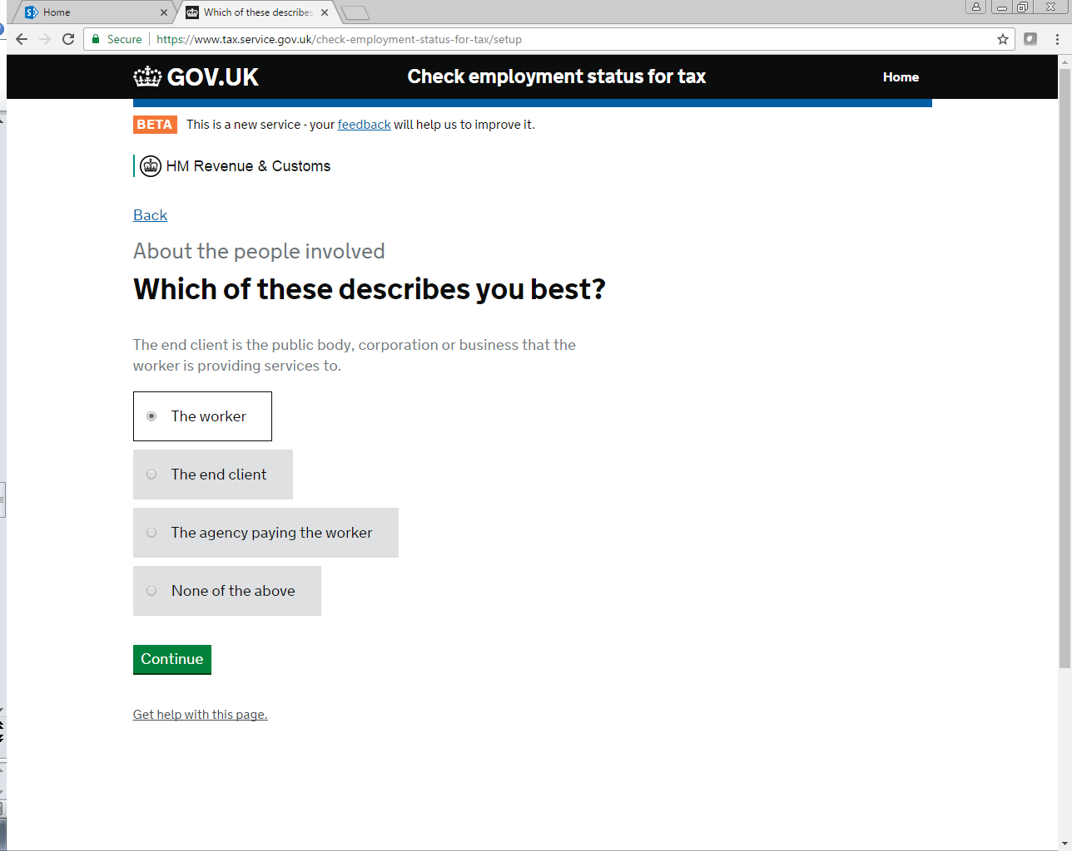
Check of Employment Status for Tax (CEST) Service
IR35: Where are we now?

Slide 13
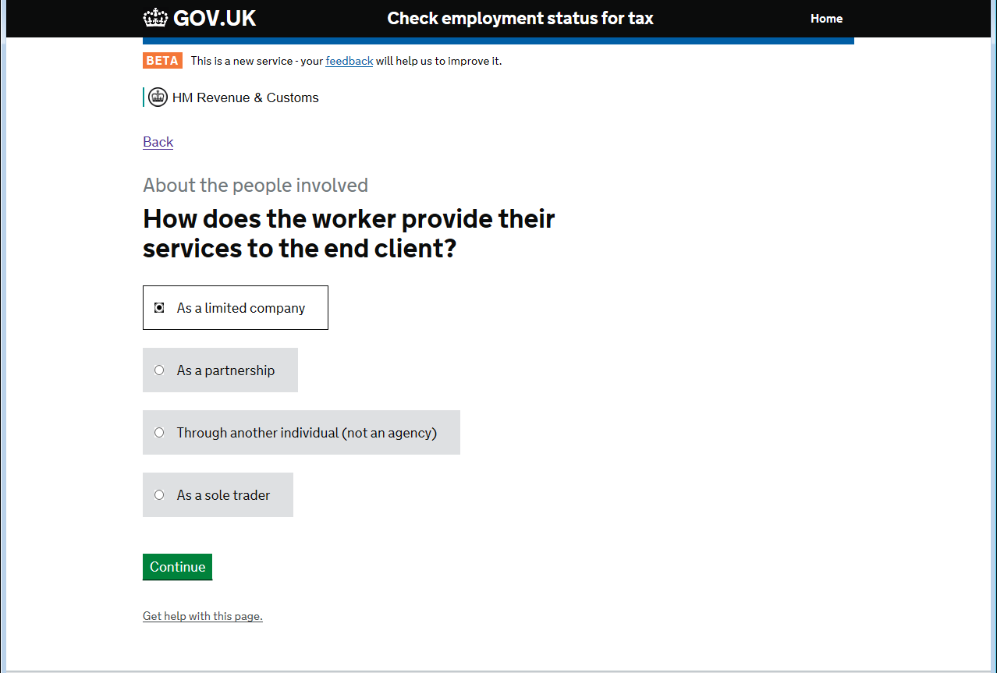
CEST
IR35: Where are we now?

Slide 14
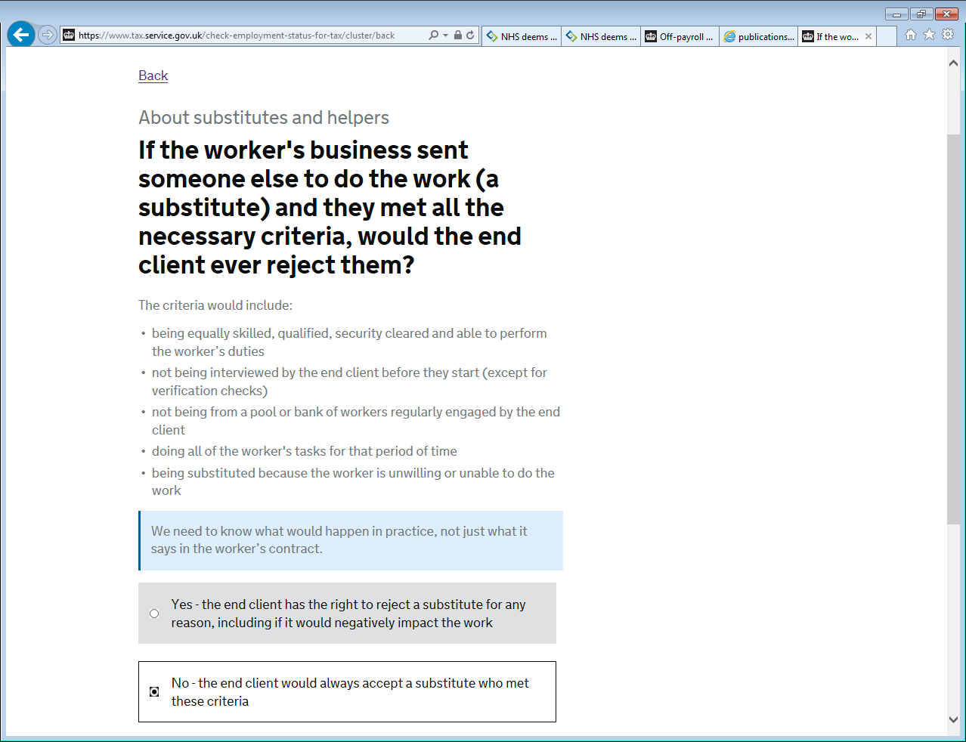
CEST
IR35: Where are we now?

Slide 15
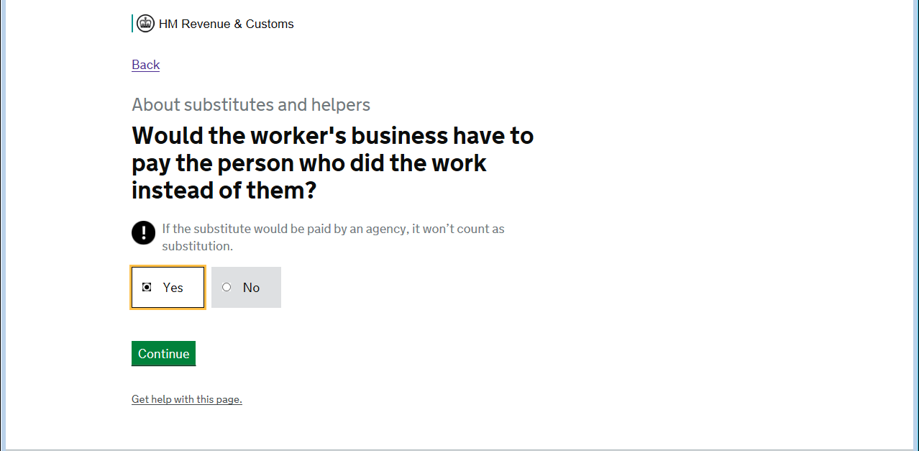
CEST
IR35: Where are we now?

Slide 16
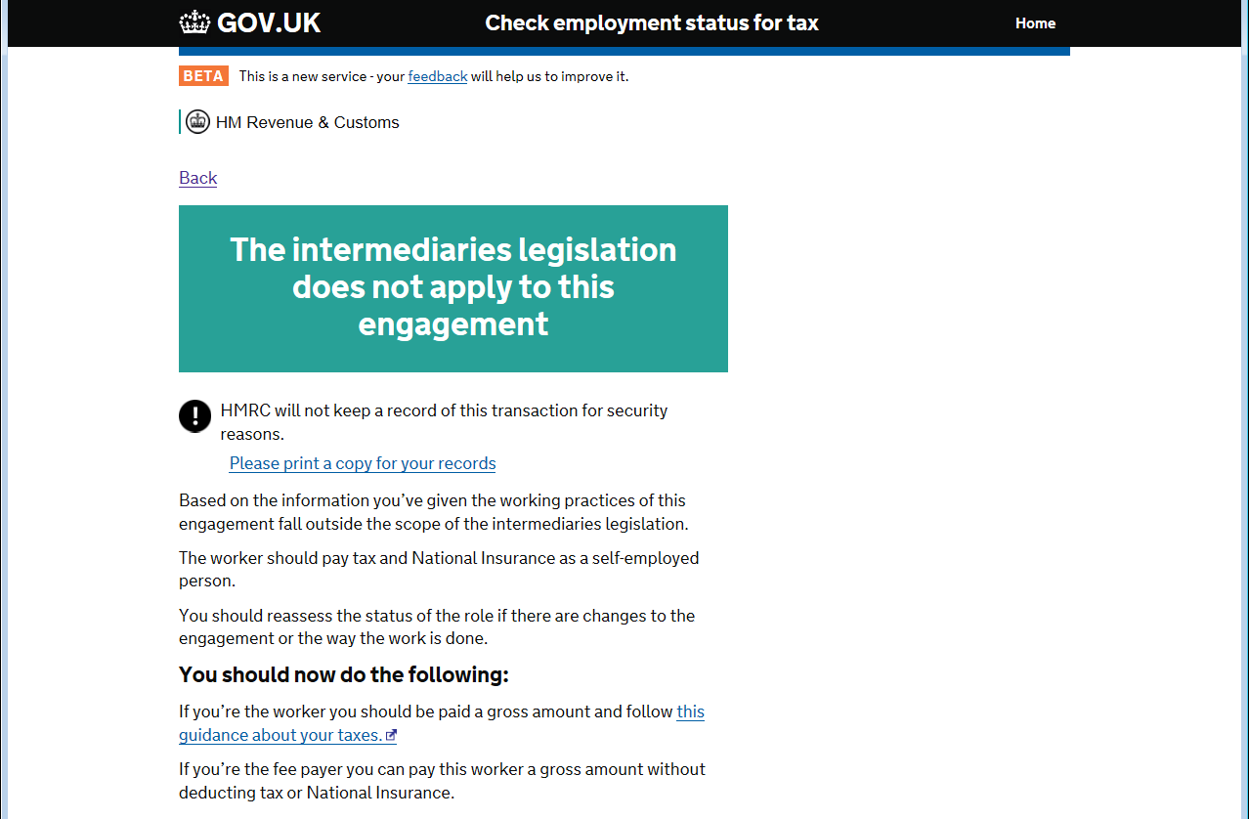
C’EST Magnifique!
IR35: Where are we now?

Slide 17
N’est-ce pas…?
IR35: Where are we now?
“About this result
HMRC will stand by the result given unless a compliance check finds the information provided isn't accurate.
HMRC won't stand by results achieved through contrived arrangements designed to get a particular outcome from the service. This would be treated as evidence of deliberate non-compliance with associated higher penalties.
HMRC can review your taxes for up to 20 years.
HMRC won’t keep a record of this result.”

Slide 18
Potential impact on the private sector
IR35: Where are we going
?
How will they decide status?
Will they be more discerning?
Agencies as fee-payers
Where might HMRC strike?

Slide 19
Other considerations
IR35: Where are we going?
Operating PSCs in the future
Umbrella company solution
Effect on fee protection

Slide 20
In the meantime
IR35: Where are we now?
Nothing has changed – yet!!
IR35 still their risk; consider independent opinion
Review contractual terms AND the working practices
Additional service to offer clients

Slide 21
In the meantime…
IR35: Where are we now?
Abbey Tax Contract Review
Discounted to £170 + VAT for this event
Quote “GP Event 2018”
contractreviews@abbeytax.co.uk
01788 702869

Slide 22
Thank you.

